Slide 1




The Diocese of Nova Scotia and Prince Edward Island
Notes:
Welcome back to Re‐Imagining Church – this is our last session! I’m Tanya.
And I’m Nicki – thanks for sticking with us all the way through!

Slide 2
The Sessions
Session 1: Brave New World?
Session 2: What is God up to?
Session 3: The School of Jesus
Session 4: Changing world, changing church
Session 5: Where do we go from here?
Session 6: Next Steps
Notes:
So . . . Let’s review where we have been over the past few weeks. In session one we thought about
our “Brave New World,” and looked at some of the changes underway in our culture and how those
changes have impacted the church.
The second session was “What in the World is God up to?”. We reviewed what spiritual resources
we have to draw on, as a kind of compass to find our way forward. In particular, we thought of
the Gospel as Good News of God’s love for the world, and God’s desire to put everything to right,
focussed in Jesus Christ. We reminded ourselves that it’s not that the church of God has a mission in
the world, but rather that the God of mission has a church in the world. And that mission is to bring the
Kingdom to life here on earth.
In session 3, we looked in more depth at what it means to be a disciple (or apprentice) of Jesus, and
how we can grow ourselves as disciples. We talked about five ingredients of spiritual growth: the
community, prayer and worship, the Bible, our faithfulness, and the Holy Spirit. We also thought
about helping others become disciples ‐ the aspect of mission we generally call evangelism.
In session 4, we thought about how different churches have adapted themselves and their
ministry to the new cultures where we find ourselves, and in particular looked at some different
kinds of “fresh expression of church.” The goal was to consider how we can change the ‘church’
container’ to make it accessible for people with whom we want to share the living water Jesus
offers, but who would probably find typical Sunday morning worship too weird.
Last week we started talking about “Where do we go from here?”, and walked through some
possibilities and resources.
This week is mostly a working session to help you get some concrete plans in place.

Slide 3
Opening Litany
3
Notes:
So let’s begin with prayer, because we really need the Spirit’s help to get our heads and hearts in the right place.
There are five short readings, and a response for the group. Could we have 5 readers?
We’ll give you each a number, so you’ll read the scripture reading on the slide with your number in the top right corner.

Slide 4
the mystery of being recognized
1
But when the fullness of time had come, God sent his Son, born of a woman, born under the law, in order to redeem those who were under the law, so that we might receive adoption as children. And because you are children, God has sent the Spirit of his Son into our hearts, crying, "Abba! Father!" So you are no longer a slave but a child, and if a child then also an heir, through God.
All: Lord, for the inexpressible delight of being loved eternally, we thank you.

Slide 5
the mystery of new life
2
He unrolled the scroll and found the place where it was written; “The Spirit of the Lord is upon me, because he has anointed me to bring good news to the poor. He has sent me to proclaim release to the captives and recovery of sight to the blind, to let the oppressed go free, to proclaim the year of the Lord’s favour.”
All: Lord, help us to reach out, that more and more people may hear the Good News.

Slide 6
the mystery of moving on
3
When they found him, they said to him, “Everyone is searching for you.” He answered, “Let us go on to the neighbouriing towns, so that I may proclaim the message there also; for that is what I came out to do.” And he went throughout Galilee, proclaiming the message in their synagogues and casting out demons.”
Mark 1:37‐39
All: Lord Jesus, sent out by the Creator, may all of God’s children feel your embrace.

Slide 7
the mystery of proclaiming
4
Many Samaritans from that city believed in him because of the woman’s testimony, “He told me everything I have ever done.” So when the Samaritans came to him, they urged him to stay with them, and he stayed two days. And because of his words many more became believers. They said to the woman, “We no longer believe just because of what you said; now we have heard for ourselves, and we know that this man really is the Savior of the world.”John 4:39‐42
All: Lord, we pray that through us many others will have the experience of you.

Slide 8
the mystery of the Spirit
5
How, then, can they call on the one they have not believed in? And how can they believe in the one of whom they have not heard? And how can they hear without someone preaching to them? And how can anyone preach unless they are sent? … So, faith comes from hearing the message, and the message is heard through the word about Christ. Romans 10: 14-17
All: Lord, breathe on us your Spirit, that your work may be accomplished.

Slide 9
Scary-o Scenarios
1 – 2 – 3 – 4 – 5 - 6
Notes:
Now, we promised last week we would start with “Scario Scenarios”. These are borrowed from MORE Mission School #4, to help us think about the every day ways we can live out our faith.
How it works is we are going to ask for a volunteer. That person will pick a number from 1 – 6. Tanya will click the number, and part of a story will come up on the screen. The volunteer will read what it says, then finish the last sentence by saying what they might say or do in the situation. Then we ask if a couple of others would suggest what they too might do.
Tanya will then add a short piece to the story, and the same volunteer will respond again, based on the new information. A couple of others can also then chime in. We will try to fit in the three of these, depending how the conversation goes. Who would like to go first?

Slide 10
DRUGSTORE DRAMA
Stopping at the Shoppers Drug Mart pharmacy to fill a prescription, you notice a tall elderly gentlemen is at the drop-off counter ahead of you. You stand aside and patiently wait your turn, then put in your order request. The clerk says it will take 5 minutes. While milling around the aisles of merchandise you notice out of the corner of your eye the man previously at the counter seated in the small waiting area. He's slumped forward with his hands cupping his face. You sense he is distraught.
You ... (do what?)
Part 2: The gentleman explains that his wife of 52 years has just been diagnosed with stage 4 cancer. You ... (say what?)

Slide 11
CHRISTIAN WITNESS WORKOUT
Your favourite fitness class is about to begin in the exercise studio next to the locker room. With your sneakers snuggly tied up, your water bottle and towel in hand, you head towards the studio room door. Within earshot you hear a young woman’s voice crack as she talks on her cell phone next to an open locker door. She says, “But I can't! I just can’t!” Breaking down in tears she bids the other person a sniffled goodbye, ends the call and stands weeping.
You ... (do what?)
Part 2: The 20-something woman blurts out that she has to get on plane in 2 hours and she is petrified to fly. She was just talking with her boyfriend and he was trying to comfort her. You…. (say what?)

Slide 12
GABBING OVER GARBAGE
It's Tuesday evening and once again you drag out your carefully-sorted Blue Bags of recyclables to the roadside.
Your new neighbour, who just arrived a couple of weeks earlier, is doing the same. A middle-aged man in a Royal Canadian Navy uniform, he hollers, "Hello" and you strike up a conversation. Introducing himself, George shares that he's a single-dad.
You ... (do what?)
Part 2: Within a few minutes you discover that George is from St. John's. You remember that there are three other military families with Newfoundland roots in your congregation. You…. (say what?)

Slide 13
A CHRISTIAN CUT ABOVE
Sharon has been your hairstylist for three months now and she is a pro with the scissors and with making conversation. Getting to know one another, you discover that she has a family background in the
Mennonite tradition. She remarks that she hasn't been to church since she was 10 years old.
You ... (do what?)
Part 2: Sharon changes the subject that day, but a few months later she mentions that her aunt died and was buried from her old church.
You…. (say what?)

Slide 14
MEDITATION MOMENT
It's Hockey Night in Canada and on your way home you stop by the liquor store for a few beers. To your surprise you run into a long-lost cousin. You ask him what he's been up to and John shares that he's been off work on sick leave for the last six months. He regularly suffers from debilitating anxiety attacks. While waiting for a referral for some counselling sessions with a psychologist, his doctor recommended he take up some form of meditation.
You ... (do what?)
Part 2: As you stand there chatting in the store, you remember that a fellow parishioner has been into Christian meditation for years and hosts a beginner group in his rec room. You…. (say what?)

Slide 15
CHATTER AT CHAPTERS
You have an hour to kill so you head to the local book store to search for a new read. Approaching your favourite section, 'Faith & Spirituality', you notice a 50-something woman in a gray business suit grazing the 'New Age' book shelf. She's frantically pulling out titles and returning them to their places. She’s obviously looking for something in particular and not finding it.
You ... (do what?)
Part 2: She tells you her boss assigned her to open a community leaders' meeting tomorrow morning with a few words. He said, "something spiritual, but not religious." The woman states that she's at a loss. You…. (say what?)

Slide 16
The View From Here
Looking back
Looking forward
What have I learned?
What happens next?
What’s the first step?
What do I need?
Notes:
All right, now we have all got our brains going and we’ve had some good laughs, here we go on the work!
In last week’s session we took some time to consider “the view from here”. That exercise took you through considering the first three questions on the slide. Hopefully over the past week you have had some time to consider the next three, but if not, that is our focus for tonight.

Slide 17
Where to Next?
World’s
Deep
Hunger
Our
Deep
Gladness
Notes:
To get us started, I want to show you a based on a quote from Frederick Buechner where he says “The place God calls you to is the place where your deep gladness and the world’s deep hunger meet.”
Do you know those things? What brings you deep gladness? What about your church congregation? What are the deep hungers or needs in your community?

Slide 18
360º Listening
Pray about the neighbourhood.
Assign a small budget.
Introduce mission
Congregational survey – what brings us joy?
Community leaders’ survey
Meet with other community churches
“on the street” survey
Discuss findings with congregation leaders
Notes:
Your own deep gladness is probably the easiest to figure out, but the other two might be a little trickier. Last week we talked about some ways to do that, and a short version of those appears here on the slide.
At this point we are going to handing the work to you! Let’s figure out what kinds of groups we need to put you in so you’ve got a group you can work with on a plan for what’s next.

Slide 19
Working Groups
What happens next?
What's the first step?
What do I need?

Slide 20
prayer
Thank you, Lord, for these weeks we have spent together.
Thank you for your Spirit among us as we have talked, and laughed, and prayed together.
Thank you for reminding us of who you are and of your love for our world.
Thank you Lord.
Notes:
Now, as we come to the end ‐ or perhaps better, to the end of the beginning ‐ let’s commit ourselves anew to the service of God and God’s mission in the world. What that means will be different for each one of us, and each of our churches. So we need to be prayerful and discerning, and supportive of one another.
Let’s pray together. We’ll follow a very simple prayer outline ‐ thank you, sorry, and please. Please do join us in saying it all together.

Slide 21
Forgive us Lord, for those times when we have lost sight of you and your work in the world.
Forgive us when we have been too comfortable and too frightened to follow where you lead.
Forgive us for forgetting what it means to be your church in the world.
Forgive us Lord.

Slide 22
We ask you, Lord, to help us discern what new things you are calling us to do.
We pray for the strength and perseverance, the courage and the resources to do your work.
We ask that many in our world may come to hear your Gospel, and may find joy in believing.
Lord, hear our prayer
Amen.

Slide 23
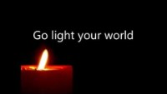

Slide 24
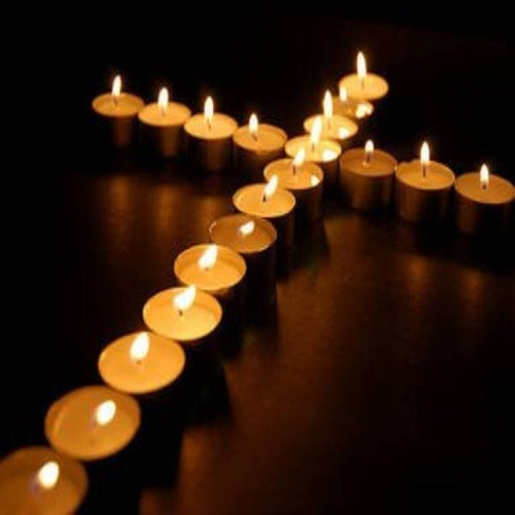
Here I am, Lord!
Notes:
We encourage you now to spend some time in quiet before God, in prayer. Remind yourself of Jesus and his call to us. We are offering ourselves anew to God’s service. Wherever it may be, whenever it may be, with whomever it may be.
God may be calling you to do something totally new. Or perhaps your role is help to revive something that was once alive but is now in decline. For some, it may be your calling to add your energy to something new that’s already under way.
Whatever it is, you and all of us are a part of the plan, and our gifts are needed in this part of God’s mission. God invites us to come alongside as apprentices.
Whenever you feel ready, light your candle and place it where we can see it, if possible.

Slide 25

a blessing
May the fire of Christ consume all indifference to God,
The light of Christ illumine our vision of God,
The love of Christ enlarge our longing for God,
The Spirit of Christ empower our service to God,
and the blessing of God Almighty,
Creator, Son and Holy Spirit,
Be among us and remain with us always.
Amen

Slide 26
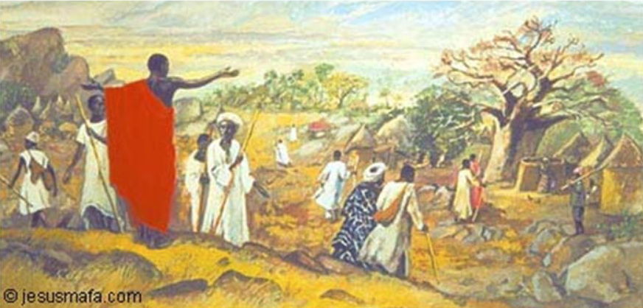
Dismissal for service
Go out into the world,
Rejoicing in the power of the Spirit!
Thanks be to God, Alleluia!

Slide 27
