Slide 1

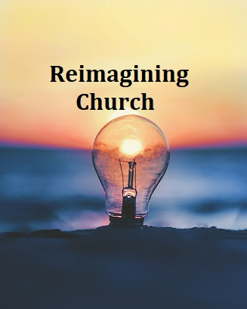


The Diocese of Nova Scotia and Prince Edward Island
Notes:
Welcome to Reimagining Church for the Diocese of Nova Scotia and Prince Edward Island!
I’m Tanya Moxley. I belong to the parish of St Nicholas, in Upper Tantallon.
And I’m Annie McQueen. I belong to the parish of The Collieries, Glace Bay. We’re delighted to have you with us online for this updated version of the program. We hope this series is reflective of where you are, your hopes and dreams, and provides some practical resources for blessing your local Anglican community.
Annie & I are both alumni of the Connectors program, which is now just wrapping up its fourth round. If you are interested to find out more about the program, please get in touch with Rev Lisa Vaughn in the Synod Office, as she will soon be looking for applicants for Connectors Five!

Slide 2
Last week:
Session 1: Brave New World?
How culture has changed – not just in the past 25 years, but even just in the past two years!
What do our churches add to our communities?
The Marks of Mission
Do our current activities reach out into our communities?
Mixed Economy churches & “Fresh Expressions”
Notes:
Some of things we talked about last week included the move to online worship, that churches are not the centre of our communities any longer, and the growing number of people in our communities that have no or only a very limited experience of “church”.
We introduced the Marks of Mission, which we will come back to throughout the program, and talked about mixed economy churches and fresh expressions of church, which aren’t church yet, but might get there.

Slide 3
For Discussion
What of all we discussed did you remember during the week?
What did you think further about?
What did you notice that was related to our sharing about the changing culture?
Notes:
We also sent you away with a bit of homework to do. We asked you to keep your eyes and ears open to the world around you in light of the things we talked about. So let’s take a few minutes now and reflect back on our last session with a Breakout Room group:
What of all we discussed did you remember during the week?
What did you think further about?
What did you notice that was related to our sharing about the changing culture?
Take 5 minutes and share your thoughts in your group.
<< Assign to Break-Out Rooms – 10 min>>

Slide 4
What in the World is God up to?
Session Two
Notes:
I hope you enjoyed your breakout room conversation!
Now we’re going to move on to tonight’s topic, “What in the World is God up to?”

Slide 5
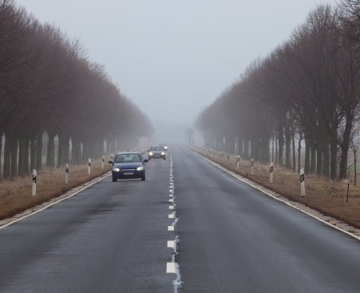
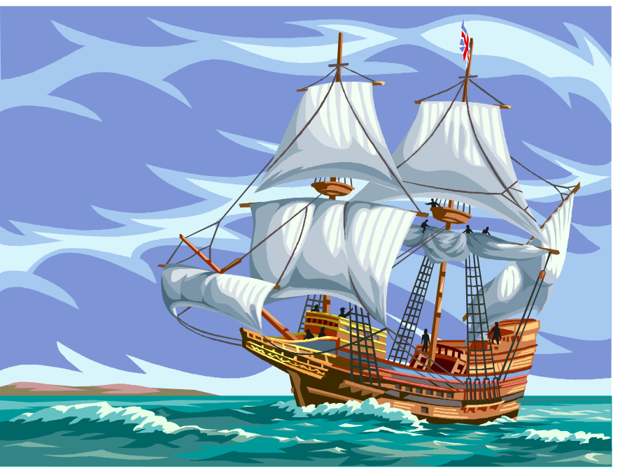
cultural changes of the past 25 years . . .
Like the change from navigating the roads to . . .
. . . navigating the oceans
5
Notes:
Here are two images which represent how cultural changes have been affecting the life of the church: driving a car on a road and sailing a ship on the oceans.
How are these two means of transport different?
Well, on the road you are more in control and there are usually signs. There are no directional signs at sea. In a car you need a map, but a compass is more useful at sea. Driving is an individual skill while sailing very far usually requires a team. Anything else you would add, just off the top of your head?
As far as church is concerned, the road map is gone, we are on the open water without a map and a much smaller crew than we think we need, and the church has to learn a whole new way of being.
As we come together today to think about what resources the church has for navigating the cultural ocean, let’s begin by focussing on God, who is at the heart of the compass.

Slide 6
worship
Almighty God, we know you are present whenever two or three have gathered in your name. We give thanks for our past and pray for a vision of the future that lies ahead. We thank you for the gift of the Holy Spirit that leads us this day and empowers us in the renewal and mission of your Church, through Jesus Christ our Lord. AMEN.
Notes:
Together, let us pray this prayer on the slide:

Slide 7
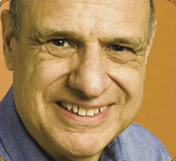
For Discussion
Dr. Tony Campolo
Would a church that throws birthday parties for prostitutes be a good thing? Why or why not?
Can you imagine such a church? What would it be like?
What would happen if the prostitutes wanted to join the church?
Would you want to belong to such a church? Why or why not?
Notes:
We asked you to watch a couple of videos in advance. We are going to get into our topic today by starting with a discussion about the Tony Campolo video. Dr. Campolo is a respected sociology professor and a Baptist speaker in the United States. How many of you had a chance to watch it?
[If not many, Tanya will do a brief summary: VIDEO: Church for prostitutes [8 min] https://www.youtube.com/watch?v=DRBM_YY_YX0 ]]
So . . . here are some questions for you to discuss in your Breakout Rooms.
Would a church that throws birthday parties for prostitutes be a good thing? Why or why not?
Can you imagine such a thing? Why or why not?
What would happen if the prostitutes wanted to join the church?
Would you want to belong to such a church? Why or why not?
<< BREAKOUT ROOMS – 10min >>
We show this little video because it raises a question that’s central to this course: what exactly is church? What is it here for? And who is it for?

Slide 8
How we think about mission
We begin with church as it is, as we have experienced it, as we assume it has always been.
We assume that God likes the way church is done at present, and does not want or need any big changes.
We assume therefore that “mission” means getting people into church as it is.
Notes:
Last week we considered what it would it mean for churches in Canada, and more specifically from the Maritimes, to disappear. Most of our answers were from the point-of-view of the church’s usefulness in society - in other words, they were sociological - lots of charitable giving would disappear, many volunteer social agencies couldn’t function. But some related to spiritual issues and to God - that is, they were theological.
When we begin thinking about the problems of the church - the fact that it is more marginal, the fact that numbers are decreasing, etc., we often reason something like this:
The way church operates is fixed; it’s always been this way. (PAUSE)
God appears to like it just as it is (even a phrase like church being “the house of God” confirms this!), (PAUSE)
therefore: surely our job - our mission - is to get people to come to church (either back to church, or to church for the first time) (PAUSE)
so they can be in touch with God.
We tend to begin by thinking about church as it is, we draw some conclusions about God based on that, and then we ask what we are supposed to do. But what if we went at it the other way round? What if, instead of beginning by thinking about church, we began by thinking about God? How might things look different?
Earlier we suggested we needed a compass. That’s key when you are on an ocean-going sailing ship. For Christians, our faith is compass, including the Bible, the creeds, and the traditions of the church. For Anglicans in particular, we say that we value Scripture, traditions, and also *Reason*. So let’s check our compass by asking three basic questions which will help us get our bearings in this new and unfamiliar world.

Slide 9

Three big questions
Question 1: What is the Gospel?
What would you say the Gospel is?
What is good news about Christianity for you?
Notes:
The first one is simply: What is the Gospel? The word Gospel of course has more than one meaning: it can simply mean the four Gospels in our Bibles, but it can also mean the message of good news which we find contained in the Gospels. Gospel, after all, means good news.
So, what is the good news about Christianity? That’s the first question we need to ask. And rather than give a theoretical answer, let me ask a personal question: What is the good news about Christianity in your life? Where does the good news of “the Gospel” make a difference to you in your life?
<<BREAKOUT ROOMS – 15 min>>
Often people will say things like, “God loves me,” “I believe in life beyond the grave,” “My sins are forgiven,” “A sense of purpose,” and so on.
The early church spread because the first Christians had heard Good News from Jesus and they had experienced it in their own lives - the kind of things you have just said - and they wanted to share that Good News with others. The Good News - the Gospel - inspired them to mission. So those things we’ve just written down about your experience of good news are not irrelevant to the church’s mission: it’s not as though the Good News is in one watertight box over here, and mission is over there in another quite different watertight box. The Good News is the beginning of mission for the church . . . and for each of us!
But there is more. How can all these things be true? The things we listed as Good News are all very different from one another. How can they all be “the Gospel”?

Slide 10
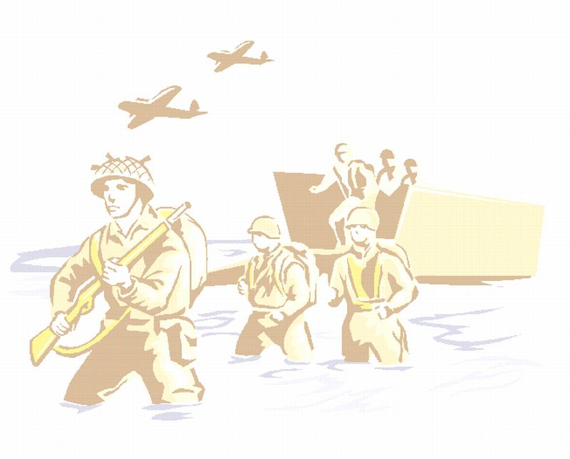
What happened at the end of World War II?
Danger of Nazism over!
Democracy safe!
Food rationing ended!
Servicemen and women came home!
Street & city signs restored!
Evacuated children returned home!
No more blackouts!
People got married!
People went to university!
Couples had children!
Notes:
Think of it this way. After the end of the Second World War in 1945, many things changed, especially in Britain.
There was lots of good news: democracy was safe, the danger of Nazism was ended, people came home from the armed forces, got married and had children; some went to university. Children who had been sent away to the country to avoid the bombing in the cities were able to go back home. Food rationing came to an end. Street signs, which had been taken down to confuse any possible invaders, were put back.

Slide 11
The end of the War meant:
My husband came home!
I got to go to university!
I got to eat bananas!
Notes:
And this good news meant different things to different people.
One might say, “My husband came home”; another might say, “The government paid for me to go to university”; and a child might say, “I got to eat bananas for the first time.”
And there is no obvious way those three things could be connected unless you knew the big overarching truth that these were all trickle-down effects of the one huge thing that had happened: the war had ended.

Slide 12
God loves me
Jesus’ resurrection gives hope
for life after death
?
My sins are forgiven
A sense of purpose
Notes:
The same is true with those things we named a few minutes ago as “good news” in our lives.
They are all true, but none of them is the full (over-arching) truth.
If you like, those too are the trickle-down effects of one big over-arching truth.
So what IS that big statement of Good News?

Slide 13

What is the Gospel?
“The time is fulfilled,
and the Kingdom of God
has come near:
repent and believe
in the Gospel!”
Mark 1:14-15
Notes:
One way to answer that is the first words of Jesus, according to Mark’s gospel.
For Mark, these are a sort of headline over all that is to come.
“The time is fulfilled, and the kingdom of God has come near; repent and believe in the Gospel.”

Slide 14
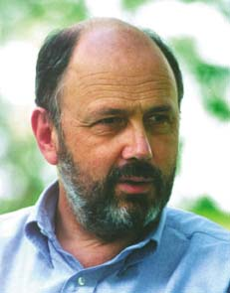
The story of the Kingdom
  Act 1: God makes a good and beautiful world
  Act 2: humankind betrays the Creator’s trust
  Act 3: the Creator starts over with the promise to Abraham
  Act 4: the Creator enters the story—lives, dies, rises again
  Act 5: we learn to play our part in God’s story
  Act 6: the Creator intervenes to bring down the curtain
Notes:
So . . . what is this Kingdom of God? Anglican Bishop Tom Wright has suggested that the Bible is like a five act play - although I think it works better if we think of it as a six-act play.
Act 1 is the story of creation: God creates a beautiful and fruitful world, and entrusts it to our care. This is nothing to do with creation or evolution: it is simply saying that behind our world, however it came into being, is a loving Creator.
Act 2 is the story of what has gone wrong in our world: we decide we know better how to run it than the Creator.
Act 3 is the story of the Old Testament: that God in love begins over, starting with Abraham and Sarah and the promise that through their descendants, blessing will be restored to the whole world.
In Act 4, the Creator writes himself into the script - as if Shakespeare should write himself into the plot of Hamlet, so that Hamlet could get to know his Creator. In the form of Jesus, he shows us what a fully human life is like, he dies for our sins, he rises from death, and he returns to heaven as Lord of Heaven and Earth.
Act 5 is where we are right now, learning to play our part in the story.
And then there is Act 6, when the creator brings down the curtain on this drama at the end of time, everything is put to rights, and a new world begins.
This is the story of the Kingdom of God.

Slide 15

What is the Gospel?
The Creator has not given up on our world, but is at work to renew the world and put everything to rights.
The heart of God’s work in the world is the life, death and resurrection of Jesus Christ.
This is the missio dei — the mission of God.
Notes:
The theme is that God the Creator has not given up on this hurting and sinful world. It says that God is at work in the world in love, putting things to rights, dealing with sin and pain and injustice - and that with the coming of Jesus, this work of the Kingdom enters a whole new strategic phrase - which is why Jesus announces that, now he has come, the Kingdom has “come near.”
So the Kingdom is the loving work of God to put right everything that is wrong in our world, and the Good News is the good news of what God is doing in the world. Another way to say this is that the Gospel is good news about the mission of God. Sometimes you will hear people use the Latin term for this: the missio dei.
And all the things we said were “good news” about Christian faith - the love of God, the forgiveness of sins, the work of the Holy Spirit, hope in the face of death, all those examples we discussed a few minutes ago - are the trickle-down effects of this big truth of the Kingdom, which is coming through Jesus Christ.

Slide 16

15 We look at Jesus, this Son, and see the God who cannot be seen. We look at this Son and see God's original purpose in everything created. 16 For everything, absolutely everything, above and below, visible and invisible, rank after rank after rank of angels—everything got started in him and finds its purpose in him. 17 He was there before any of it came into existence and holds it all together right up to this moment. 18 And when it comes to the church, he organizes and holds it together, like a head does a body. 19 So spacious is he, so roomy, that everything of God finds its proper place in him without crowding. 20 Not only that, but all the broken and dislocated pieces of the universe—people and things, animals and atoms –get properly fixed and fit together in vibrant harmonies, all because of his death, his blood that poured down from the Cross.
Colossians 1:15-20, The Message
Notes:
On that note, our Bible passage for this session is from Paul’s letter to the Colossians, where he puts the idea of the Kingdom - God’s work of restoring the world - in different terms.
This is from a contemporary version of the Bible called The Message, which you may know. Anyone want to volunteer to read it?
We look at Jesus, this Son, and see the God who cannot be seen. We look at this Son and see God's original purpose in everything created. For everything, absolutely everything, above and below, visible and invisible, rank after rank after rank of angels - everything got started in him and finds its purpose in him. He was there before any of it came into existence and holds it all together right up to this moment. And when it comes to the church, he organizes and holds it together, like a head does a body. So spacious is he, so roomy, that everything of God finds its proper place in him without crowding. Not only that, but all the broken and dislocated pieces of the universe - people and things, animals and atoms - get properly fixed and fit together in vibrant harmonies, all because of his death, his blood that poured down from the Cross.

Slide 17
For Discussion
What is one thing you learn about Jesus from this passage?
How does this passage relate to Jesus’ teaching about the kingdom?
What is one encouraging thing for you in this passage?
Notes:
Here are three questions for us to think about:
What is one thing you learn about Jesus from this passage?
How does this passage relate to Jesus’ teaching about the kingdom?
What is one encouraging thing for you in this passage?
Take a minute to write down your own short answers to these questions.
Now take a few more and discuss them as a group. Make sure someone writes down a few notes.
<< Breakout Rooms – 10min>>

Slide 18
Three big questions
Question 2: What is the Church?
What is the Church to you?
What would the person in the street say the Church is?
Notes:
All right, welcome back. Now that we’ve gotten a start on the answer to What is the Gospel?
We move on to #2 of our Big Questions: What is the church?
Let’s start by asking: What answers might the person on the street give to the question, What is the church?
I’m going to send you to your Breakout Rooms. Take a minute to make a list of your own answers. Then write down a few words describing how you believe people “on the street” or “in your community” might feel about the church.
Take a few minutes with your group to discuss the similarities and differences in your answers to those 2 questions.
<<BREAKOUT ROOMS – 10 min>>

Slide 19
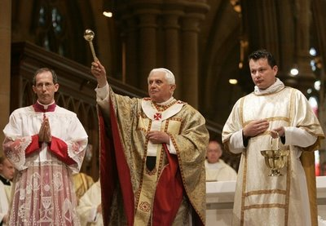
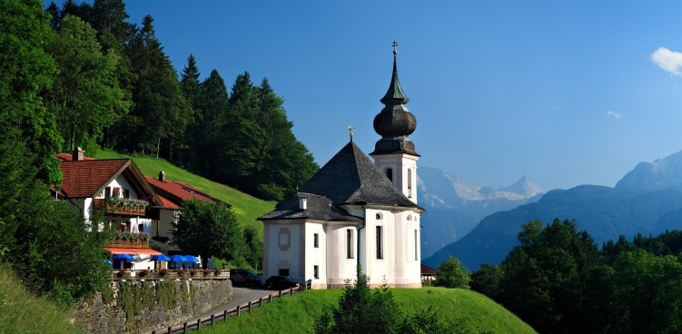
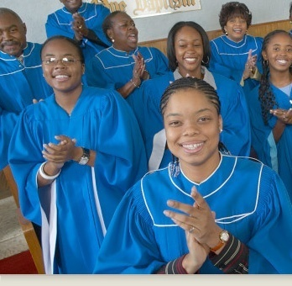
Notes:
For “people in your community” you may have had responses along these lines:
The church is a building/an institution,
A collection of old religious folk,
A bunch of hypocrites,
That place that does the dinner theatre shows / Blessing of the Animals, etc..
Or maybe even: A place for people to develop their spirituality.
For those of us already “in” the church, answers might include:
The church is where my friends are
A place to experience God
The building where we worship
A community gathering place
→ what else?
Now think about what we said about the Gospel. The Gospel is the Good News of the Kingdom: that in Jesus Christ God is at work putting the world back together. This is the mission of God.
So we need to ask: How does the church relate to the Gospel?

Slide 20
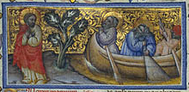
Jesus came to Galilee, proclaiming the good news of God, 15 and saying, The time is fulfilled, and the kingdom of God has come near; repent, and believe in the good news. 16 As Jesus passed along the Sea of Galilee, he saw Simon and his brother Andrew casting a net into the sea—for they were fishermen. 17 And Jesus said to them, Follow me and I will make you fish for people. 18 And immediately they left their nets and followed him. 19 As he went a little farther, he saw James son of Zebedee and his brother John, who were in their boat mending the nets. 20 Immediately he called them; and they left their father Zebedee in the boat with the hired men, and followed him. Mark 1:14-20
Notes:
Think back to that story of Jesus announcing the Kingdom. The kingdom is here, he says. So repent and believe: turn your lives around, go God’s way instead of your own way.
And what’s the very next thing that happens? He invites four people to join him in the work of the Kingdom!

Slide 21
How does church relate to Gospel?
If the Gospel is that God is at work to restore all things through Jesus Christ . . .
The heart of Church is the community of those who have responded to Jesus’ call (“repent and believe”) by baptism to join God in God’s work
The Gospel creates the Church
Notes:
We can put it like this:
If the Gospel is that God is at work to restore all things through Jesus Christ THEN the heart of Church is people who have responded to Jesus’ call to “repent and believe”, much like those first four fishermen.
So it is the Gospel that creates the Church. Without the Gospel, there would be no church. If we forget the Gospel, we forget what church is for.
If we forget that we are part of the mission of God, the church will just become another religious institution.
Conversely, if we want the church to flourish, the first thing we need to do is remember the Gospel, and that the church exists to serve the Gospel and God’s mission in the world.
In 1997’s Beyond Duty: A Passion for Christ, a Heart for Mission, Tim Dearborn says:

Slide 22
It’s not that the church of God
has a mission in the world,
but that
the God of mission
has a church in the world
Notes:
It’s not that the church of God has a mission in the world, but rather that the God of mission has a church in the world.
And that mission is to bring the Kingdom to life here in the world.

Slide 23
Three big questions
Question 3: What is a Christian?
What would you say?
Notes:
So on to our third question: What is a Christian?
In a sense, we’ve already answered this one.
How would you express it, in the light of what we’ve said so far?
<< BREAKOUT ROOMS – 10min>>
Write your responses down with some brief notes.

Slide 24
Three big questions
Question 3: What is a Christian?
Someone who has responded to Jesus’ invitation to be a disciple
Someone who has become a part of God’s mission to transform the world
Someone who in baptism has joined the church, which is God’s mission agency
Notes:
Some of your group answers may have been things like this:
A Christian is someone who:
has responded to Jesus’ invitation to be a disciple; or
has become a part of God’s mission to transform the world; or
in baptism has joined the church, which is God’s mission agency.
The next question, of course, is what that might mean in practice. We’ll talk about this in more detail next time. For now, let’s look at what it meant for one church to realise its calling to be involved in God’s mission.

Slide 25
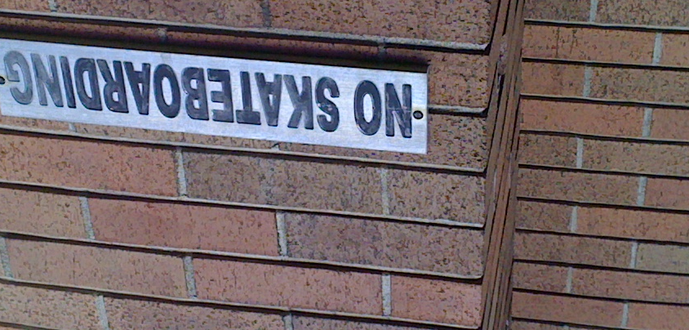
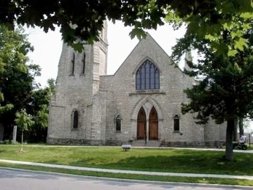
St James, Perth, Ontario
The Skater Church
Notes:
Here’s the background. Suppose you show up at church one Sunday morning, and you discover that the church hall has been broken into. At first you think things must have been stolen, but then you notice that all the tables have been pulled out and collapsed at one end and that there are what appear to be wheel marks on the floor. Suddenly it dawns on you: these are not thieves, these are young people using your church hall as a skate park and your tables as ramps. What do you do?
Many would say: call the police, put extra locks on the doors and windows, put up a “Trespassers will be prosecuted” sign, and hire a security guard for the nights. Or you could simply put up a sign saying “No skateboarding,” as one church did.
Skater Church, which we asked you to watch in advance, is the story of a church in Perth, Ontario, where exactly that happened, and what they did about it. If you didn’t get a chance to watch it, basically what happened is that they had a choice to welcome or not. They chose to invite the skater group into their space, and were amazed to discover not just interest in the Gospel message, but also mentoring opportunities between the kids and church members. The group grew both in numbers and to include an opening time of worship and sharing, and some kids who started in the group as “just” members grew to take on leadership roles in the group and in the community.
VIDEO: - Skater Church https://www.youtube.com/watch?v=InwkB35jQRg
Take a few minutes now and discuss the video.
<<BREAKOUT ROOMS – 10min>>

Slide 26
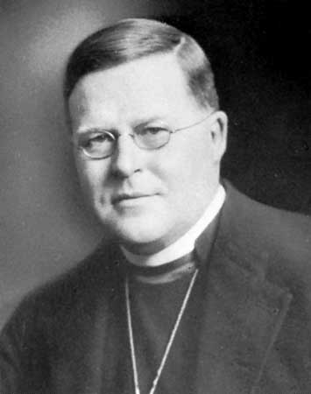
The church is the only society in the world that exists for the benefit of its non-members.
William Temple
Archbishop of Canterbury
Notes:
William Temple, once Archbishop of Canterbury, said,
“The church is the only society in the world that exists for the benefit of its non-members.”
Some of the people at St James’ immediately thought, “This is our church, the church of our members, so we need to keep these people out.” But then, someone else thought, “No, we exist for our non-members, and these are our non-members!” In other words, they remembered that the church exists as part of God’s mission to restore the whole world. They began to think “missionally.”
Of course, this is not the only way for a church to be involved in the mission of God, and we will think about some other ways in our other sessions. But it`s a great example to begin with.

Slide 27

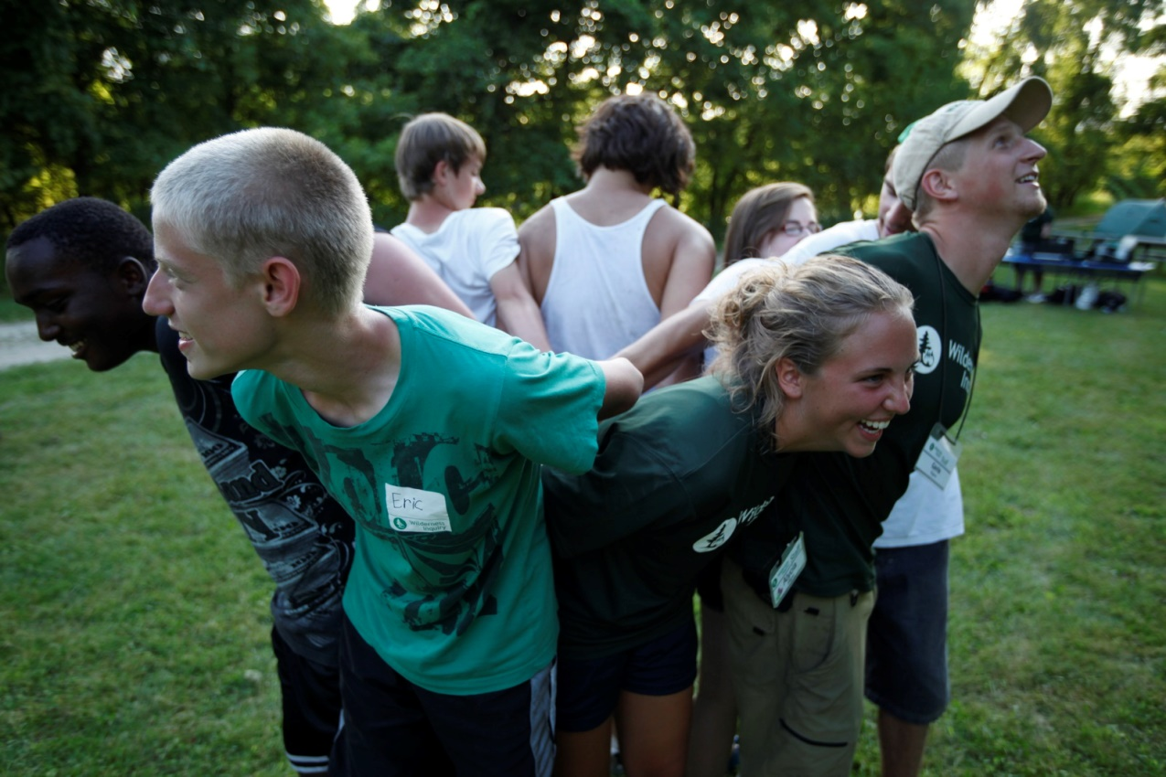
Notes:
In the in-person version of this program, we asked those gathered to hold hands with the people on either side of them, so perhaps imagine that you are doing so in person. In our case, we are already looking at each other, and because of our conversations so far, you may already feel “closer” to some people here than you might when sitting across a meeting room with some folks from your church. This is might be more like how church ought to be - a place of growing trust, intimacy, and connectedness, where we minister to one another - and I know many of you are from churches like that.
But whether we meet in a building, on in a group facing each other, or even online like this, all we are offering to outsiders - to our non-members - is our backs, not our eyes and not our hands. So now imagine if you would, that you are letting go of the hands beside you, turn to face away from your screen, and even look out a window if you safely can, and imagine holding hands again.
Does it feel different? We are still together, we are still supporting one another, and yet we have a different focus. We’re looking outwards to God’s world, the world where God is involved in mission, and where God calls us to be too.
We could say that the inward-looking church is maintenance mode – looking after the membership and structures they already have. Alternatively, we could call the outward-looking church “missional”. We need to look after our members, of course, but we also need mission, and it is all too easy to emphasize the first and forget the second. We must remember here the first two Marks of Mission:
To *proclaim* the Good News of the Kingdom, and To teach, baptize and nurture new believers.
These are the ones that come first, and the others follow.

Slide 28



Time for Reflection – The Examen
When was I encouraged, or touched, or joyful?
What might God be saying?
How might I respond?
When was I troubled, or sad, or angry?
What might God be saying?
How might I respond?
Notes:
We are going to wrap up with some time for personal reflection. You may wish to have a pen and paper handy to make some notes in response to the question we are going to ask. [Mute everyone]
As we have talked tonight, what have been the moments when you felt positive - encouraged, touched, even joyful?
Were there some things that your spirit said YES to? It may have been something that was said by someone today, an image on the screen, a story, a video, or even a memory.
What made it special?
What might God be saying to you?
Were there moments that caused your heart to sink?
Times when you felt troubled, sad or angry?
It may be something that was said, or something you saw on the screen.
Can you identify what made it difficult?
What might God be saying to you about that?
How might you need to respond?
Remember: God is present in both the joyful and uncomfortable feelings!

Slide 29
For next week . . .
Think of someone you know who has no church connection—and maybe never did.
What would church look like for them?
If they came to your church as it presently is, what would they like?
What would they find weird or difficult?
If you could design a church that they would want to attend, what would it be like?
Notes:
Lastly, your homework!
We ask you over this coming week to think of someone you know who has no church connection - and maybe never did.
What would church look like for them?
If they came to your church as it presently is, what would they like?
What would they find weird or difficult?
If they could design a church that they would want to be a part of, what would it be like?

Slide 30
closing prayer
Almighty God —
You call your people to proclaim afresh in every generation the good news of Jesus your Son.
By the power of your Spirit rekindle in us gifts of courage and compassion.
Open our eyes to see your grace at work beyond our church buildings and institutions.
Help us to work with you in building communities of faith allowing your mission to be expressed in our hurting world.
May we proclaim afresh your faithfulness and constant love in a changing and uncertain world.
For the building of your kingdom and to glory of your name. Through Jesus Christ our Lord. Amen
Notes:
We turn all these things into our prayers. As Christians gathered here today, let’s pray together the prayer on the screen

Slide 31
    Next week . . .
    The School of Jesus
    See you then!
Notes:
Next session, we’ll have a chance to check in with your reflections.
Our topic will be “The School of Jesus.”
There will be videos to watch in advance again, so watch for Tanya’s reminder e-mail on Sunday!

Slide 32
Program Resources
Go to https://www.nspeidiocese.ca/cmc-vsst
Click on Re-Imagining Church at the bottom of the left side menu
You can re-watch any of the videos we have shown, or the previous session(s)

