Slide 1

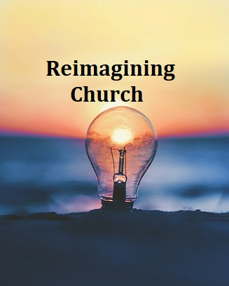


The Diocese of Nova Scotia and Prince Edward Island
Notes:
Welcome to session three of Reimagining Church ‐ I’m still Tanya!
And I’m still Annie!
Thanks for joining us for Session Three of Reimagining Church 2022. Today’s session is “The School of Jesus”, but first we’re going to pray, and then we’ll refresh our memory about last week and review the work we asked you to do since then.

Slide 2
Opening Prayer
Jesus Christ, thank you for coming to our world to be our Lord and our Servant, to live and die and rise again for us.
Help us, as we seek to be your disciples, to learn what that means for our lives, and for the churches we belong to.
And give us power and courage then to follow you. We pray in your name, Amen.
Notes:
Let us pray together the prayer on the slide.
Jesus Christ, thank you for coming to our world to be our Lord and our Servant, to live and die and rise again for us.
Help us, as we seek to be your disciples, to learn what that means for our lives, and for the churches we belong to.
And give us power and courage then to follow you. We pray in your name, Amen.
Now, to refresh our memory from last week! We were reminded that before we can reconsider how to be church in our current culture, we have to go back to the Gospel.

Slide 3
What is the Gospel?
The Creator has not given up on our world,
but is at work to renew the world
and put everything to rights.
The heart of God’s work in the world
is the life, death and resurrection of Jesus Christ.
This is the missio dei - the mission of God.
Notes:
We suggested last time that the Gospel is the Good News that God has not given up on this world. Instead, God is at work through Jesus Christ to restore all that is broken or hurting or sinful ‐ what Jesus calls “the renewal of all things”. In other words, bringing God’s Kingdom to life, here on earth.
We mentioned the phrase the “mission of God,” or in Latin, the “missio dei.” Then we thought about the church, and that the church is made up of those who have believed and experienced something of this Good News, and who then become servants of God – disciples of Jesus ‐ to continue the work of the kingdom.
We also want to remind you about the first two Marks of Mission and their call to action for all disciples:
To proclaim the Good News of the Kingdom, and
To teach, baptize and nurture new believers
Now, let’s review your homework.

Slide 4

Homework . . .
Think of someone who has no church connection.
If they came in to your faith community as it presently is, what would they like?
What would be weird or difficult?
Describe a church that they would want to attend.
Notes:
We asked you to think of someone you know who has no church connection ‐ and maybe never did. If they came to your church as it presently is, what would they like? What would they find weird or difficult? If you could design a church that they would want to attend, what would it be like?
How did that reflection process go for you? Take a few minutes to discuss your findings and see if there are any common themes in the responses.
<< Break‐Out Rooms – 10 min>>
Now, just hang on to those thoughts for a bit as we get into this week’s session, called “The School of Jesus”. We’re going to consider in more detail how we are involved in this mission of God to bring the Kingdom to life here on earth.
Let’s start by going back to that story at the beginning of Mark’s Gospel, where Jesus announces that the Kingdom is at hand, and calls the four fishermen to follow him.

Slide 5

After John was put in prison, Jesus went into Galilee, proclaiming the good news of God. “The time has come,” he said. “The kingdom of God has come near. Repent and believe the good news!”
As Jesus walked beside the Sea of Galilee, he saw Simon and his brother Andrew casting a net into the lake, for they were fishermen. “Come, follow me,” Jesus said, “and I will send you out to fish for people.” At once they left their nets and followed him.
When he had gone a little farther, he saw James son of Zebedee and his brother John in a boat, preparing their nets. Without delay he called them, and they left their father Zebedee in the boat with the hired men and followed him.
- Mark 1:14-20
Notes:
Would one of you volunteer to read this for us?
<<Reading from slide>>
What is the connection between Jesus’ message and the calling of the four fishermen?
What do you think? Once he’d announced the kingdom, Jesus added the words: “Repent and believe.” So . . . do these four fishermen repent and believe?
It depends what those words mean, doesn’t it?
If “repentance” means going around in dust and ashes, grovelling and doing long penances, then no they don’t. And if “believe” means signing your name to a particular creed which you are then expected to recite, then no, clearly they don’t do that either.

Slide 6
“Repent” = to change your mind
“Believe” = to give your allegiance to something
So then:
1. You turn away from one thing, then you…
2. Turn towards something else
In other words, you’ve made a 180 degree U-turn
Notes:
The word “repent” means literally “to change your mind” ‐ to think differently about things; and “believe” means to commit yourself, to give your allegiance to something (or someone) new. These are really two halves of one whole: to turn away from one thing and to turn towards another: a complete 180 degree U‐turn.
Do these four fishermen “repent and believe”? Well, up to now, they thought that life was about taking care of your family, and doing an honest day’s work, going to the synagogue on the Sabbath, and having a drink and a laugh with your friends. And there’s nothing wrong with those things. These four weren’t exactly big time sinners ‐ they were just decent ordinary guys minding their own business and getting on with their lives.
But now Jesus turns up and they realize they were wrong. They realize those are not the most important things in life after all: there’s something much bigger ‐ something absolutely huge: it’s the Kingdom that’s important ‐ this amazing work of God in the world.
So yes, they repent ‐ they change their minds about what is important in life ‐ and they believe ‐ they commit to being followers of Jesus. And for them nothing is ever the same again. It’s as simple as that.
This has always been at heart of Christianity: it’s never been about being religious, or enjoying organ music, or serving on church committees, or making crafts for the Christmas bazaar. It’s not about following rules or participating in rituals. Christianity, first and foremost, is about turning to follow Jesus.
Since those early days of the apostles, the way that someone expresses their response to the Gospel is baptism. And it’s significant just what it is that people are asked when they want to be baptized.

Slide 7
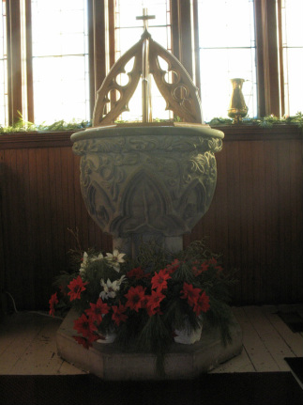
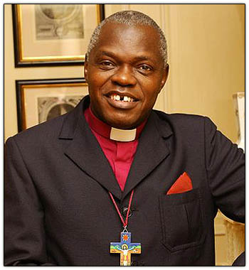
The commitment of baptism
John Sentamu
Archbishop of York
Notes:
John Sentamu is Archbishop of York in England and, in the video we asked you to watch, he holds an outdoor baptism on the steps of York Minster. Did you catch the questions he asks of the people presenting themselves for baptism?
Sentamu video: https://www.youtube.com/watch?v=C_tOiQOG_g4
What were the questions he asked? Do you turn to Christ? Do you repent of your sins? Do you renounce evil?
All baptisms follow more or less that form. Let’s look a little more closely at those questions.

Slide 8
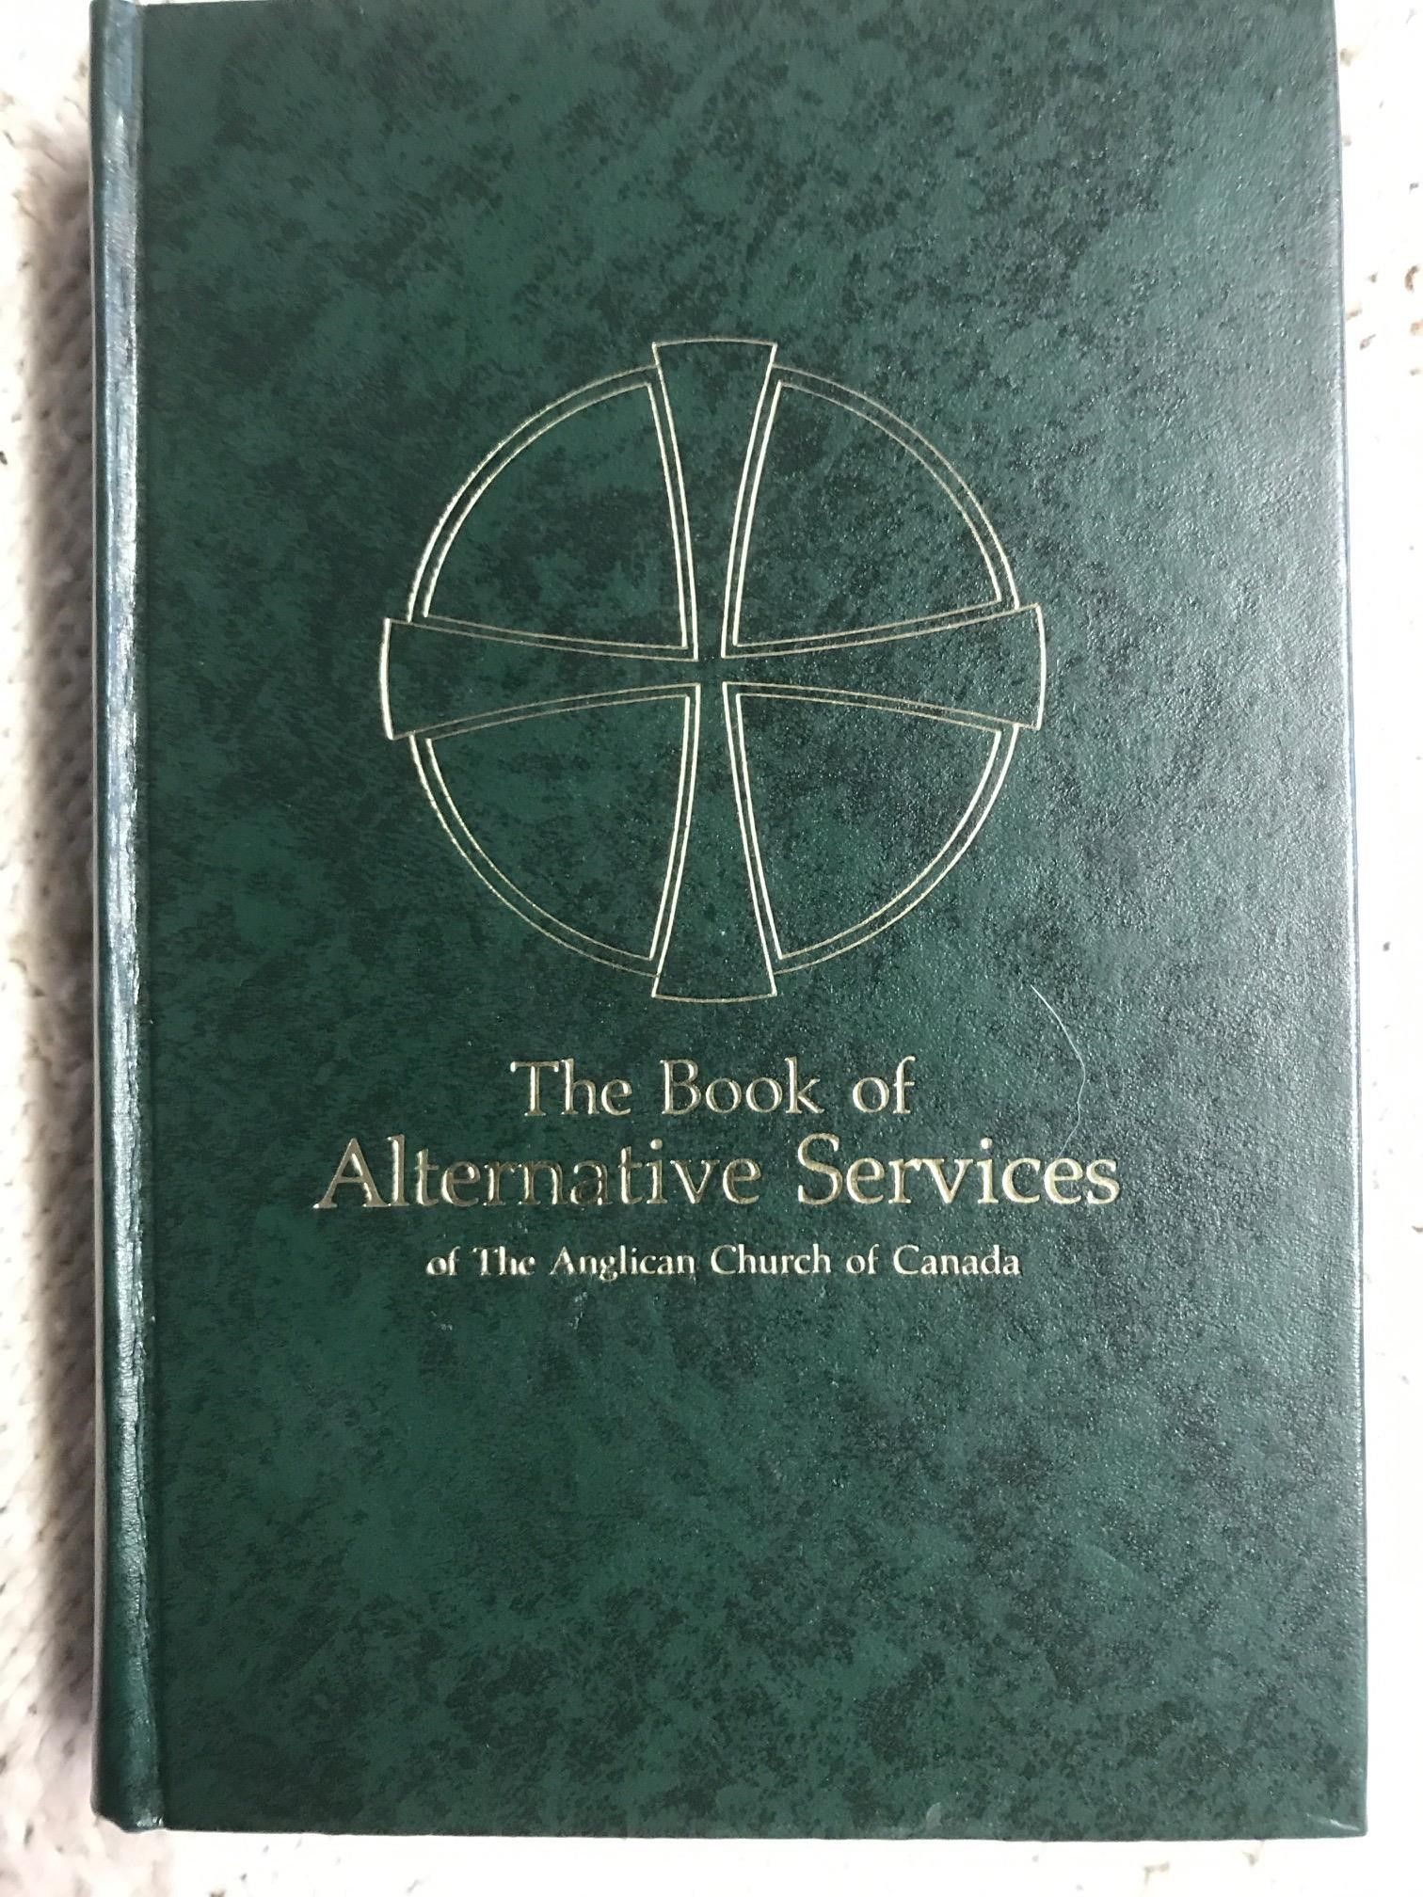
Baptismal Promises
Do you renounce Satan and all the spiritual forces of wickedness that rebel against God?
  I renounce them.
Do you renounce the evil powers of this world which corrupt and destroy the creatures of God?
  I renounce them.
Do you renounce all sinful desires that draw you from the love of God?
  I renounce them.
Do you turn to Jesus Christ and accept him as your Saviour? I do.
Do you put your whole trust in his grace and love? I do.
Do you promise to obey him as your Lord? I do
REPENTANCE
BELIEF
Notes:
You can see the promises on the slide ‐ How are those two sets of questions different?
The first is negative, the second positive.
The first is turning away and the second turning toward.
They are reflecting Jesus’ command to repent (to change your mind ‐ in this case about everything that is evil) ‐ that’s the first group of questions ‐ and to believe (give your allegiance to something else ‐ in this case, Jesus Christ) ‐that’s the focus of the second set of questions.
So even today, when someone becomes a Christian, they follow in the footsteps of the first four disciples all those years ago. Baptism means taking your place in the mission of God by becoming a follower of Jesus. Let’s take this a step further.
What is a Christian? The first Christians didn’t often call themselves Christians. The word is only used three times in the New Testament, and in the first place it was a name that other people gave them, not a name they chose for themselves. There was a different word that they preferred to describe themselves.
It’s DISCIPLE.
The most common word in the New Testament is a disciple. And disciple means follower, learner and student.

Slide 9
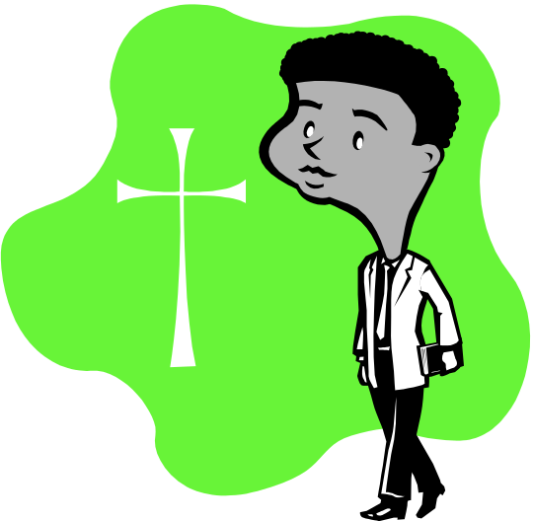

What is a Christian?
Most common word in New Testament: “disciple”
What is a disciple?
  A follower, a learner, a student
  An apprentice
Notes:
The most literal meaning of “disciple” is “learner.” We might say “student,” except that, for us, “student” often means sitting in a row listening to a teacher at the front giving a lecture. And although Jesus did some lecturing, like the Sermon on the Mount, that wasn’t the main way the disciples learned.
A word that might help us more is “apprentice”. Has anyone here served an apprenticeship? At the heart of this kind of learning is not reading books, or sitting in a class ‐ though there may be some of that ‐ but primarily you accompany someone who is experienced in the thing you want to learn (carpentry, midwifery etc.), and learn “on the job.”
The disciples seemed to have lived and learned their faith first & foremost as an apprenticeship, and the church was their apprenticeship school. Jesus is the Master Craftsman, and his disciples are learning his “trade” from him.

Slide 10
Jesus Trains His Apprentices
When the crowds found out and followed him, he welcomed them and spoke to them about the kingdom of God, and healed those who needed healing. Late in the afternoon the Twelve came to him and said, “Send the crowd away so they can go to the surrounding villages and countryside and find food and lodging, because we are in a remote place here.” He replied, “You give them something to eat.” They answered, “We have only five loaves of bread and two fish—unless we go and buy food for all this crowd.” (About five thousand men were there.) But he said to his disciples, “Have them sit down in groups of about fifty each.” The disciples did so, and everyone sat down. Taking the five loaves and the two fish and looking up to heaven, he gave thanks and broke them. Then he gave them to the disciples to distribute to the people. They all ate and were satisfied, and the disciples picked up twelve basketfuls of broken pieces that were left over.
Luke 9:11-17
Notes:
Can you think of examples of how Jesus trained the disciples to be his apprentices?
Here’s a passage that covers several examples. This scripture passage is from Luke chapter 9. Would someone volunteer to read it for us?
<<Reading>>

Slide 11
For Discussion
Make a list of the things that Jesus does in the passage we read.
List the things the disciples do.
What do you think Jesus wanted to teach them through this experience?
What do you think they learned through this experience?
How have you been helped to be a disciple of Jesus?
Notes:
How do we learn in the “trade school” of Jesus?
How have you been helped to be a disciple of Jesus?
We’ll take two minutes in silence now for you to reflect and make some notes about that.
<< 2 minutes quiet >>
Take some time now in your Break Out Rooms to share your reflections if you want to, and discuss the questions on the slide.
<<Break Out Rooms – 15 min>>

Slide 12
Five things that enable us to grow as disciples
Community
Worship & Prayer
Scripture
Responsive Choices
The Holy Spirit
Notes:
Welcome back! We hope your discussions are proving both fruitful and informative!
We suggest there are normally five things that enable us to develop as disciples:
Community
Worship & Prayer
Scripture
Responsive Choices
The Holy Spirit

Slide 13

1. Community
Notes:
The first is Community.
As God works to renew the world, God is not just interested in renewed individuals: God is interested in community, and how people relate to one another.
The simple fact of being in a church community, hanging in there through thick and thin, watching how others express their faith, learning to work alongside people we don’t necessarily see eye to eye with ‐ and even learning to love them ‐ that’s part of our apprenticeship. Many of you described how you found a mentor in the Christian community: that’s another way community helps.

Slide 14
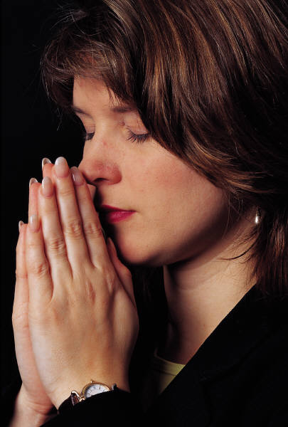
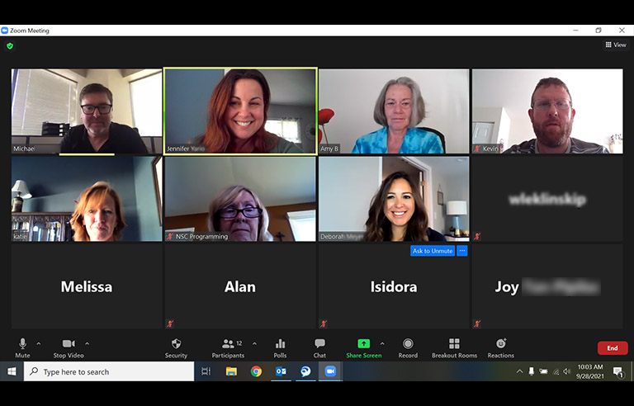
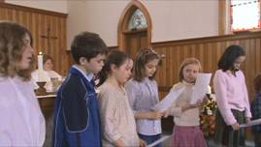
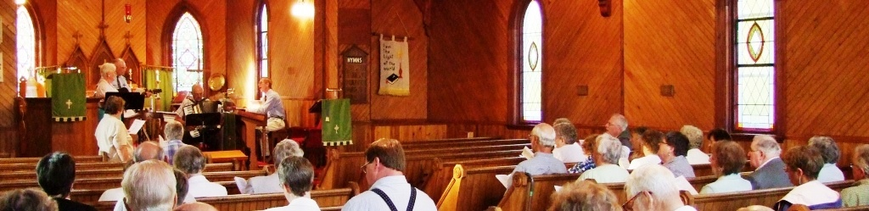
2. Worship and prayer
Notes:
The second area is Worship and prayer. There are a variety of ways we do these, and they changed very quickly during the COVID19 pandemic. Key questions for us as we emerge from the pandemic are:
What worked?
What didn’t?
What did we learn that will help us and others on our discipleship journey?
Prayer is one of the ways we stay close to our Teacher.

Slide 15
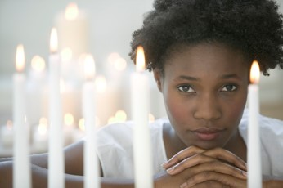
Prayer can be . . .
alone or with others
at set times or spontaneous
using printed prayers or made-up prayers
How we do it is secondary:
that we do it is crucial!
Notes:
Prayer can be by ourselves or with others. It can be at specific times ‐ say at the beginning and the end of the day ‐ or it can be spontaneous ‐ at any point as our day unfolds, as the need arises.
It can make use of written prayers, or it can be conversational, as though we are talking to a friend. (In fact, we are talking to a Friend, so that’s just fine!)
How we do it is secondary:
that we do it is what is crucial.
So . . . why is prayer so important to our discipleship?

Slide 16
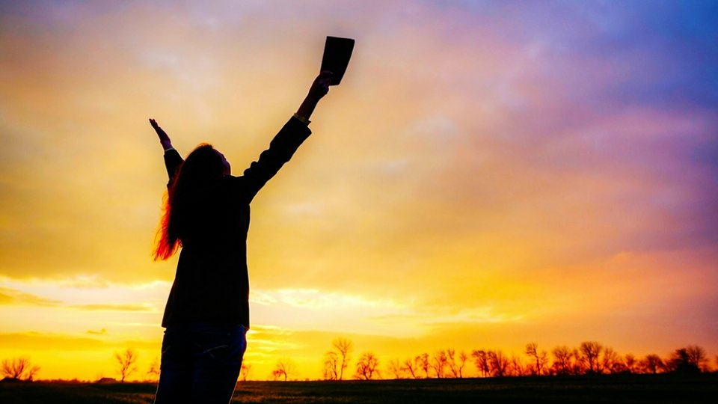
How prayer helps our discipleship:
All relationships are strengthened by free and open conversation
Prayer invites our Teacher to act in the situations of our lives
Prayer is a way of listening to our Teacher
Notes:
First, all relationships are strengthened by free and open conversation, so at a very basic level, prayer strengthens our relationship to Jesus.
Secondly, when we bring our needs and the needs of others to Jesus, it is as though it opens a door for him to be involved in the situation, and for us to observe how he works.
Lastly, prayer is also a way of listening to the Teacher. We can ask: “Lord, what are you doing in this situation?” Or, “Dear God, what are you trying to say to me?” “Lord, is there something you want me to do or to learn here?”
So one thing that prayer does is to help us grow in discipleship. But that’s also one of the functions of worship. For example, in our Anglican traditions ‐ the most important act of worship pre-COVID was the Eucharist. For many months during the pandemic many of us “fasted” from Communion. What was that experience like for you and your congregation?
<< group discussion / input>>

Slide 17
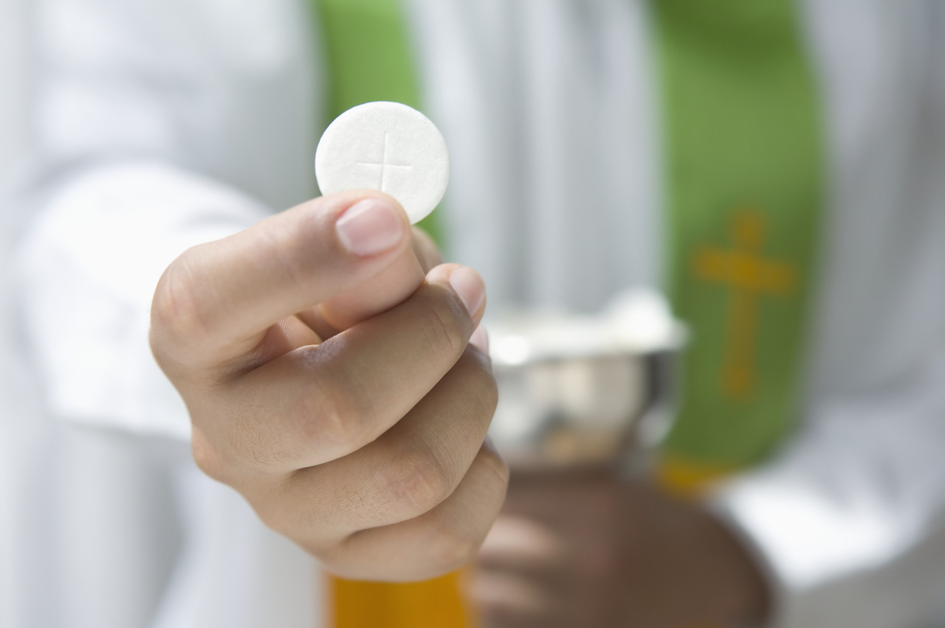
Eucharist and mission
... It is indeed right that we should praise you, gracious God, for you created all things (Act 1) ...
When we turned away from you in sin (Act 2), you did not cease to care for us but opened a path of salvation for all people.
You made a covenant with your people Israel, and through your servants Abraham and Sarah gave the promise of a blessing to all nations (Act 3).
Eucharistic Prayer 1
The Book of Alternative Services
Notes:
Here too, the fact that we are disciples in the carrying out of Jesus’ mission is central.
In the prayer of consecration, or what we may call the Great Thanksgiving or the Eucharistic Prayer, we acknowledge, in part, that our Creator “opened a path of salvation for all people” and that God has intervened in our world in the person of Jesus. This action of God is what we have been calling the mission of God.

Slide 18
Eucharist and Mission
In the fullness of time, you sent your Son, Jesus Christ, to share our human nature, to live and die as one of us, to reconcile us to you... (Act 4)
God
May we, who share his body, live his risen life; we who drink his Cup, bring life to others; we, whom the Spirit lights, give light to the world.
Jesus
Mission
Mission
Communion
Disciples
He gave it to his disciples saying “Take, eat, this is my body”
Notes:
Jesus chooses twelve disciples to work with him, and then, at the end of his earthly ministry, he celebrates with them what we have come to call the Eucharist or the Last Supper. Every time we hold out our hands to receive communion, the blessed bread and wine, we are identifying ourselves with those disciples and saying, “Yes, Jesus, we are your disciples too. Yes, Jesus, we are committed to you and your mission to renew all things.”

Slide 19
Eucharist and Mission
The Creator sends the Son to the world in mission.
God
At the end of the service, we are sent out to continue to work alongside Jesus in the work of the Kingdom.
Jesus
Jesus calls disciples to be apprentices in his work.
Mission
Mission
Communion
Disciples
In Communion we are drawn once again into God’s story: “Do this in remembrance of me”.
Notes:
This is why at the end of the service we say these words: “May we, who share his body, live his risen life; we, who drink his cup, bring life to others; we, whom the Spirit lights, give light to the world.” There is the mission, continuing in and through us, Jesus’ disciples today.
Did “fasting” from Eucharist during the pandemic take away from our feeling of being called to mission? Are you back to Eucharist every week now? Has that changed your desire to do mission in your community?
<<group input>>
At the end of the service we are blessed and sent out with new strength and vision to take part in God’s mission to the world. So that is factor number 2 ‐ worship and prayer.

Slide 20

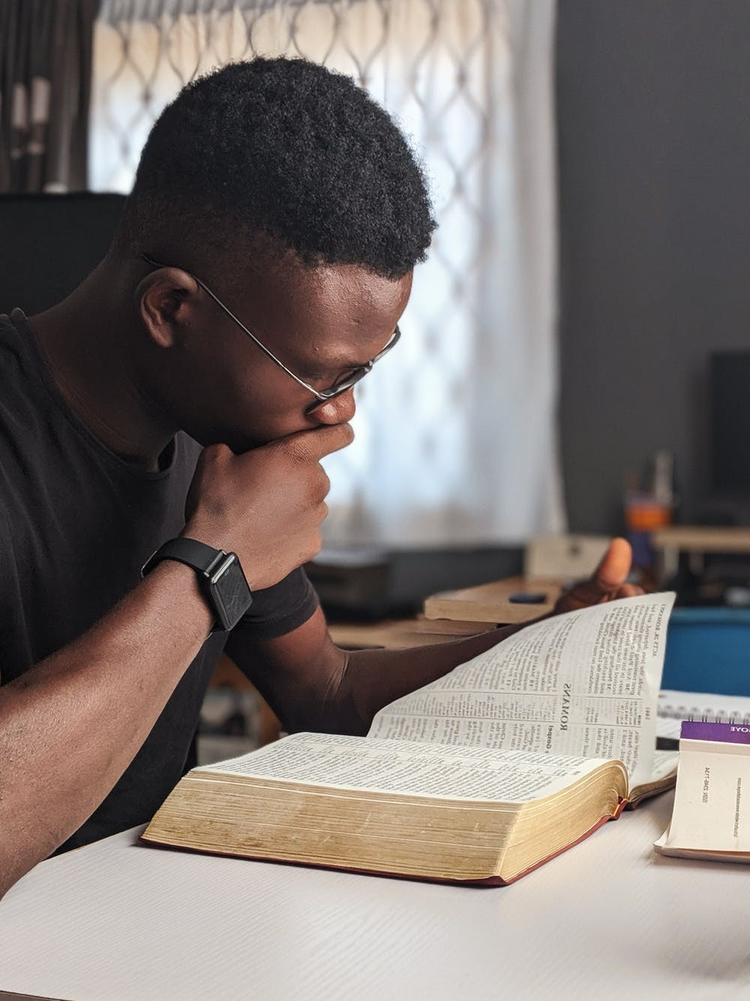

3. Scripture
Notes:
Factor number three of the five things that enable us to develop as disciples is Scripture.
How does the Bible play a part in our discipleship? It’s dangerous simply to quote verses out of context and think that’s what God is saying we should do ‐ lots of people have got into trouble that way.
But on the other hand we can’t just dismiss the Bible as an old, irrelevant book.

Slide 21

The story of the Kingdom
  Act 1: God makes a good, beautiful world
  Act 2: Humankind betrays the Creator
  Act 3: the Creator starts over with the
  promise to Abraham
  Act 4: the Creator enters the story
  Act 5: we learn to play our part in God’s
  story
  Act 6: the Creator intervenes to bring down
  the curtain
Notes:
You may remember that last time we referred to Bishop Tom Wright, who suggested that the Bible can be thought of like a play. We didn’t say much about Act 5 then, except that that’s where we are now. But Tom Wright says this: suppose that tomorrow a previously unknown play of Shakespeare’s was discovered ‐ but there’s one act, Act 5, missing. What could you do?
He suggests that the most interesting thing to do would be to get together the world’s most experienced Shakespearian actors, get them to read Acts 1 through 4, and Act 6, until it is second nature to them ‐ and then set them loose to act out the play. Then when they came to Act 5, they would improvise! They wouldn’t be entirely making it up out of nothing – good improvisation would have to be true to Acts 1 through 4, and the way they finish Act 5 has to connect with the start of Act 6.

Slide 22
The story of the Kingdom
  Our calling:
  Faithful improvisation
Notes:
Tom Wright says this is a helpful way to think of how we relate to the Bible, because that’s how God gives us a framework for our lives ‐ Acts 1, 2, 3, 4 and 6. All the clues for how to act out Act 5 are right there. It’s up to us to figure out what it means to live out Act 5 of God’s story in our lives and our neighbourhoods.
You might describe what we are called to do “faithful improvisation”. In other words, since the Bible didn’t envision many of the situations we face in our world, we must both improvise and at the same time be faithful - because we are living a new part of the same story as people in the Bible.

Slide 23
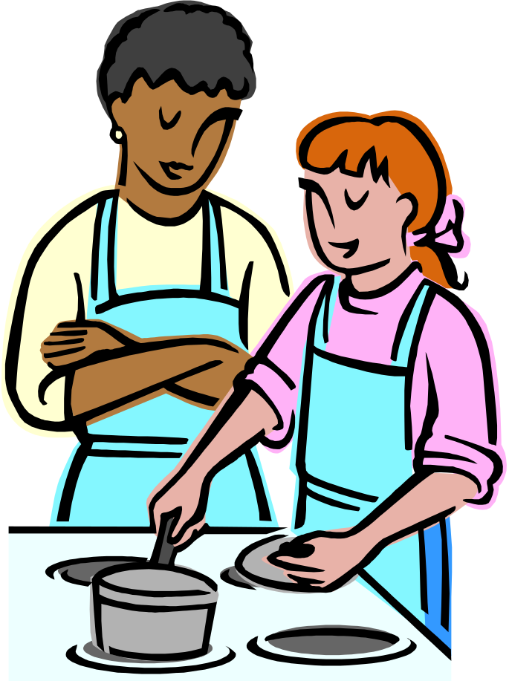
4. Responsive choices
“Why do you call me Lord, Lord, and do not do what I tell you?”
- Luke 6:46
Notes:
The fourth factor that enables us to grow as disciples has to do with the responsive choices we make about how we live.
Jesus once said, “Why do call me “Lord, Lord”, and do not do what I tell you?”
It’s no use following a Master Craftsman around and watching them at work unless we then go on to try it ourselves by following the master’s instructions. Apprentices don’t get their certification just by watching, or by doing things their own way! Watching is part of learning, but it’s not the whole of it. You have to learn to do what your Master tells you to do or you will never be more than an “armchair apprentice.”
If we are disciples of Jesus, it must make a difference in the way we live. Every day, there will be situations where, if we were not disciples, we might choose to do one thing, but, because we are disciples, we will choose to do something else. In particular, where we might otherwise have done something that would serve our own interests, or been destructive to someone else’s, now we try to choose to serve the interests of the Kingdom ‐ even when it’s costly and or embarrassing.
What examples can you think of? Take 5 minutes now in your group and write down a least six brief answers.
<<BREAK OUT ROOMS>> - check that folks understand what to do…

Slide 24

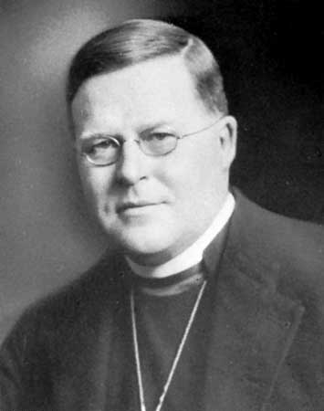
5. The Holy Spirit
It’s no good giving me a play like Hamlet or King Lear and telling me to write a play like that. Shakespeare could do it; I can’t. And it is no good showing me a life like the life of Jesus and telling me to live a life like that. Jesus could do it; I can’t. But if the genius of Shakespeare could come and live in me, then I could write plays like his. And if the Spirit of Jesus could come and live in me, then I could live a life like his.
Archbishop William Temple
Notes:
The last element in discipleship is really the most important, but it’s not one we always remember – The Holy Spirit.
Archbishop William Temple once said: “It’s no good giving me a play like Hamlet or King Lear and telling me to write a play like that. Shakespeare could do it; I can’t. And it is no good showing me a life like the life of Jesus and telling me to live a life like that. Jesus could do it; I can’t. But if the genius of Shakespeare could come and live in me, then I could write plays like his. And if the Spirit of Jesus could come and live in me, then I could live a life like his.”
Temple’s point is that this is exactly what Jesus has promised. Jesus says he will come to us in the form of the Spirit. He will enter into our experience, work within our personality, skills, and experience, and help us make possible a lifestyle we would have thought impossible before becoming a disciple.
And in fact it’s the Holy Spirit that makes possible all those aspects of the apprenticeship we’ve been thinking about.

Slide 25
The Holy Spirit
  Creates community
  Makes Jesus real in worship and prayer
  Helps us understand how to live in the story of the Bible
  Gives us strength and creativity to do what Jesus asks of us
Notes:
It’s the Spirit of Jesus working in us that creates Christian community, so that we can work and worship and pray with other people. It’s that Spirit who makes Jesus real to us in prayer and worship. It’s that Spirit who helps us understand the Bible and figure out what to do about the things we read. And it’s the Spirit who gives us strength of will and creativity to carry out the “assignments” God gives us.
Now you may be asking: What does all this have to do with reimagining church? Or fresh expressions of church? The answer is: everything!
The only reason for starting new Christian communities is so that people will have the opportunity to become apprentices of Jesus who would not otherwise. Or, to put it another way, fresh expressions of church give people the opportunity to hear the Good News ‐ the Gospel ‐ who would otherwise never know about it. It’s about being church in a way that is culturally appropriate for them. We’ll talk in more detail about this next time.

Slide 26
Pause for reflection
Where are we at in our discipleship?
  Is “discipleship” a new idea for you?
  Are we seeking to be faithful apprentices?
  Do you feel enthusiastic about it? Nervous? Curious?
  Are we part-time apprentices who should be full-time?
Notes:
Before we head off in a slightly different direction, let’s pause for reflection. You may want to jot some things down in response to the questions on the slide.
<<2-3 min pause>>
Now, as we re‐imagine church and consider fresh expressions of Christian community, we know that a church will only be effective in God’s mission if it is, at its heart, a community of Jesus’ apprentices. One of the things Jesus asked his followers to do as part of his mission is to “make disciples.” But only disciples can make disciples, so this has to be our starting point!

Slide 27
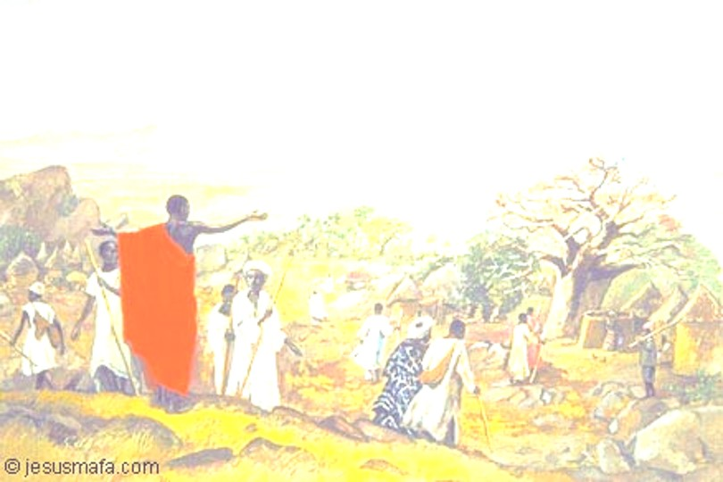
The Great Commission
Then the eleven disciples went to Galilee, to the mountain where Jesus had told them to go. When they saw him, they worshiped him; but some doubted. Then Jesus came to them and said, “All authority in heaven and on earth has been given to me. Therefore go and make disciples of all nations, baptizing them in the name of the Father and of the Son and of the Holy Spirit, and teaching them to obey everything I have commanded you. And surely I am with you always, to the very end of the age.” Matthew 28.16-20
Notes:
Let’s look at the place in scripture where Jesus says this. These are his last words before his ascension ‐ if you like, his famous last words—traditionally known as The Great Commission.
Would one of you read this for us?
<<Reading from slide>>
We’ve said that our task is to co‐operate with Jesus in the work of God’s kingdom. And part of that work is helping other people become apprentices of Jesus too. How do we do that? The traditional term for this is evangelism. For some
Christians, evangelism is “the E‐word” ‐ something nice people don’t talk about in public.

Slide 28

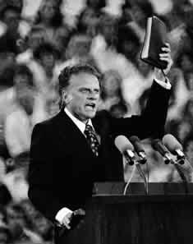
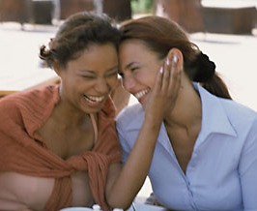
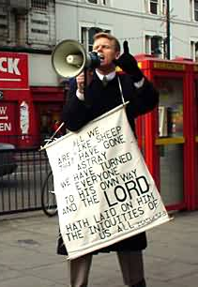
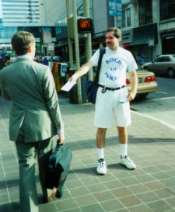
Images of evangelism— positive and negative
Notes:
Let’s do a quick spot test. When you hear the word evangelism, what do you think of?
<< group input >>
Some words & images you think of will be positive, but for many people more will be negative.
List them on your paper, separating them into to columns ‐ positive on one side and negative on the other.
Take a few minutes to do this with your group
<<BREAK OUT ROOMS>>
How many of you had a longer “negative” list than a “positive” one?
<Get some input on their answers if we have time>>

Slide 29
What is Evangelism?
co-operating with the Holy Spirit
to help people
take steps towards
being apprentices of Jesus.
Notes:
We are going to suggest a definition of evangelism which may help:
“Evangelism is co‐operating with the Holy Spirit to help people take steps towards being apprentices of Jesus.”
This definition reminds that first of all, evangelism is not really our work. It is the work of the Holy Spirit to help people become disciples of Jesus. That should take some pressure off us, since it’s not all dependent on us. But it’s still pretty challenging, since it means we have to make ourselves available to the Holy Spirit to be involved in this work ‐ and who knows where that might lead us?

Slide 30

What is Evangelism?
THE REAL EVANGELIST
co-operating with the Holy Spirit
THE CHURCH’S ROLE
to help people
THE HOW
take steps towards
THE GOAL
being apprentices of Jesus
Notes:
This definition also identifies the GOAL of evangelism. It’s not about making people religious, or getting them to make a “decision for Christ,” or persuading them to attend our church. It is about helping them decide to become an apprentice ‐ a follower, a disciple of Jesus. Why? Because, as we’ve been saying, the Good News is that God is renewing the whole world through Jesus Christ, and all of us are invited to be part of that. That’s what we were made for. It’s not always easy, as you well know, but it is ultimately the road to joy.
This definition also explains HOW evangelism happens. It’s a process of “taking steps,” and there may be very many of those steps and it often takes a long time. People who become Christians as adults say it often took months or even years for them to come to the point of becoming a disciple and asking for baptism.

Slide 31
Ways the church can help
  Be a welcoming community
  Talk about our own experiences
  Offer Christianity 101 –type courses
  Lend a book, recommend a website
  Pray for people, pray with people
Notes:
So what can the church do? We can HELP. How do we do that? There are lots of things “inherited” churches can do.
We can be a welcoming community, where people who are thinking about faith can see a Christian community in action, with all its strengths and weaknesses. Often people “belong” before they “believe.”
We can talk about own experience of following Jesus.
We can help by offering Christianity‐101 courses or Bible study programs for beginners, where people can find answers to their questions, or even realize that questions about faith are okay!
We can lend an engaging book or refer people to a helpful web site.
We can pray for them and with them.
It is important to remember though, that we are building relationships with people because we care about them, and want them to know the power of the Good News – not because we want more “bums in seats” on Sunday mornings! Nobody wants to be “a project”.
There are a many helpful things churches can do to help people take steps towards discipleship. We just need to be make sure we know that the “helping” is part of our responsibility as disciples. It has to be part of our own lives and the life of our congregation.

Slide 32
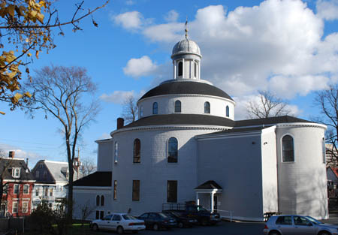
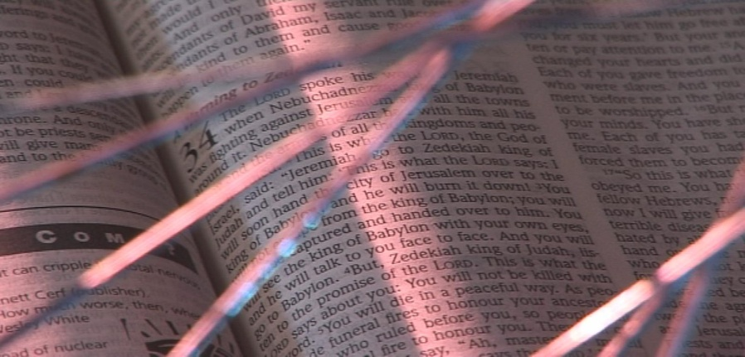
the mixed economy church
establish fresh
expressions
help inherited churches
engage their communities
32
Notes:
Now, remember Rowan Williams’ phrase about “the mixed economy”?
There are increasing numbers of people who are never going to turn up at our churches on a Sunday morning, however warm and welcoming they may be. It’s simply too much of a cultural jump for them. If those people ‐ and there are more of them all the time ‐ are to hear the Good News of the Kingdom, and have the opportunity to become apprentices of Jesus too, then the church will have to go where they are, not wait for them to come to us.
And the churches that will emerge in those places where the church has never been before may look very different from those we’re used to. That’s why they’re called “fresh expressions of church.”

Slide 33

Destination Church
A Christian Reform church plant in St. Thomas, Ontario
https://www.destinationchurch.ca/
What did you like about the video? What questions does it leave you with?
Notes:
“Destination Church” is example from St Thomas, Ontario. It is church that was started for people who had no connection with church. We asked you to watch it in advance, so you would have some time to talk about it tonight. Destination Church serves the community in some unusual ways, and is in the business of making disciples.
Destination Church video link: https://www.youtube.com/watch?v=r29eZVOA‐7Y
Take a few moments now and discuss amongst yourselves this idea of a fresh expression of church.
What did you like about the video? What questions does it leave you with?
<<BREAK OUT ROOMS>>
Destination Church is just one example of a fresh expression and how it can be effective in making disciples. Next time, we will look in more detail at what it means to be a church, and how other people have been working out new ways to be church in various cultures

Slide 34



Time for Reflection – The Examen
When was I encouraged, or touched, or joyful?
What might God be saying?
How might I respond?
When was I troubled, or sad, or angry?
What might God be saying?
How might I respond?
Notes:
We are going to wrap up with some time for personal reflection. You may wish to have a pen and paper handy to make some notes in response to the question we are going to ask. [Mute everyone]
As we have talked tonight, what have been the moments when you felt positive - encouraged, touched, even joyful?
Were there some things that your spirit said YES to? It may have been something that was said by someone today, an image on the screen, a story, a video, or even a memory.
What made it special?
What might God be saying to you?
Were there moments that caused your heart to sink?
Times when you felt troubled, sad or angry?
It may be something that was said, or something you saw on the screen.
Can you identify what made it difficult?
What might God be saying to you about that?
How might you need to respond?
Remember: God is present in both the joyful and uncomfortable feelings!

Slide 35

The Doxology
Glory to God, whose power working in us can do infinitely more then we can ask or imagine. Glory to God, from generation to generation, in the church and in Christ Jesus, for ever and ever. Amen.
Notes:
We turn all these things into our prayers. As Christians gathered here today, let’s pray together the doxology:
Glory to God, whose power working in us can do infinitely more then we can ask or imagine. Glory to God, from generation to generation, in the church and in Christ Jesus, for ever and ever. Amen.

Slide 36
Next week…
Changing World, Changing Church
Notes:
Only a little bit of homework this time. We ask you to let this session’s teaching and discussion percolate over the week. In particular, reflect on what it means to be a disciple. And, what about evangelism? Are your views of the “E‐word” beginning to shift?
We’ll see you next session, for the topic “Changing world, changing church.”
Bye for now!

