Slide 1




The Diocese of Nova Scotia and Prince Edward Island
Notes:
Hi, and welcome back to Re-imagining Church, refreshed for 2022. I’m Tanya!
And I’m Annie. Before we go any farther, let’s begin with a moment of silence and then we’ll pray the prayer on the next slide together:

Slide 2
Prayer
Almighty God, by your grace you have given us new life in Jesus Christ. By your Spirit you have called us to proclaim His Name throughout the world. Awaken in us such a love for you and your work that we may so boldly share Jesus Christ in word and deed that all people may come to know him as Saviour and follow him as Lord, to the glory of your name. Amen.

Slide 3
The Sessions
Session 1: Brave New World?
Session 2: What is God up to?
Session 3: The School of Jesus
Session 4: Changing world, changing church
Session 5: Where do we go from here?
Session 6: Next Steps
Notes:
Let’s begin by taking a minute to review where we’ve been so far.
In Session One, Brave New World?, we discussed our very rapid move to online worship, that over the past several decades churches have become less and less the centre of our communities, and the growing number of people in our communities who have no, or only a very limited, experience of “church”.
In Session Two, What in the World is God up to?, we suggested that the Gospel is the Good News that God has not given up on this world. Instead, God is at work through Jesus Christ to restore all that is broken or hurting or sinful - what Jesus calls “the renewal of all things”. In other words, bringing God’s Kingdom to life, here on earth.

Slide 4
Last week
The School of Jesus
What it means to live as an apprentice of Jesus, learning to do the work of the Kingdom of God.
Evangelism
Co-operating with the Holy Spirit to help people take steps towards being apprentices of Jesus.
Notes:
Last week’s topic was The School of Jesus, and what it means to live as an apprentice of Jesus, learning to do the work of the Kingdom of God. We also talked about evangelism, and we suggested as a definition that evangelism is “co-operating with the Holy Spirit to help people take steps towards being apprentices of Jesus”. In other words, giving others the opportunity to become disciples and play their part in God’s work.
In this session we want to look more closely at what it means to be church in our changing culture.

Slide 5
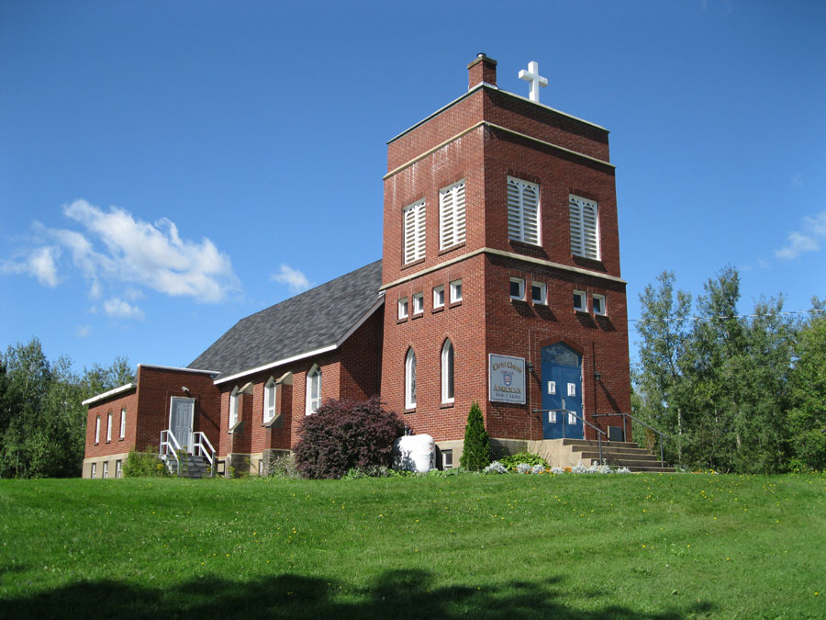
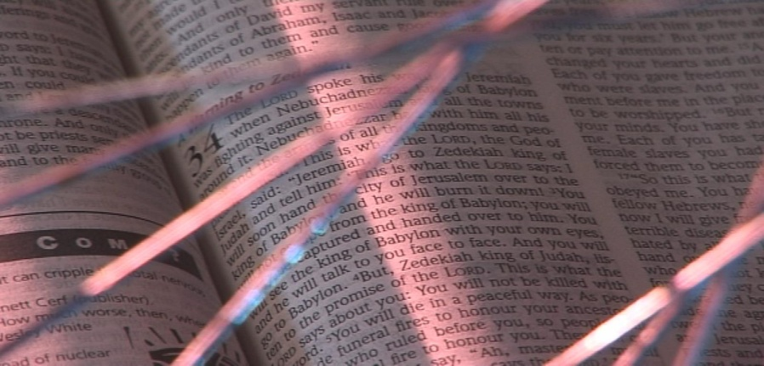
the mixed economy church
establish fresh
expressions
help inherited churches
engage their communities
5
Notes:
You will be familiar by now with Rowan Williams’ phrase, “the mixed economy.” This is shorthand for saying that our culture increasingly needs different kinds of church.
There is an important place for “inherited churches” - churches that have been around a long time, are well-established, and have lots of potential. For them the challenge is to become missional, and use their resources to reach out to those not presently involved in church.
But there are many people - perhaps the majority of the de-churched and unchurched - who will never relate to traditional church because it simply isn’t part of their culture. So alongside helping inherited churches, we will ALSO have to explore different ways of doing and being church to connect with them. These are the so-called “fresh expressions of church.”
Hence the title of tonight’s session: Changing World, Changing Church

Slide 6

How much can we change church to suit people’s culture?
When does it stop being church?
Notes:
The questions we’re going to consider tonight are:
How far can we change the church to suit people’s culture?
When does it stop being church?
Any church that has more than one service has already begun to adapt to people’s culture. Some prefer the quiet 8 o’clock service with the old Prayer Book while others prefer the lively family service at 11 a.m. For others a midweek Eucharist suits their busy lifestyle better than Sundays. But how far can this kind of adaptation go?

Slide 7
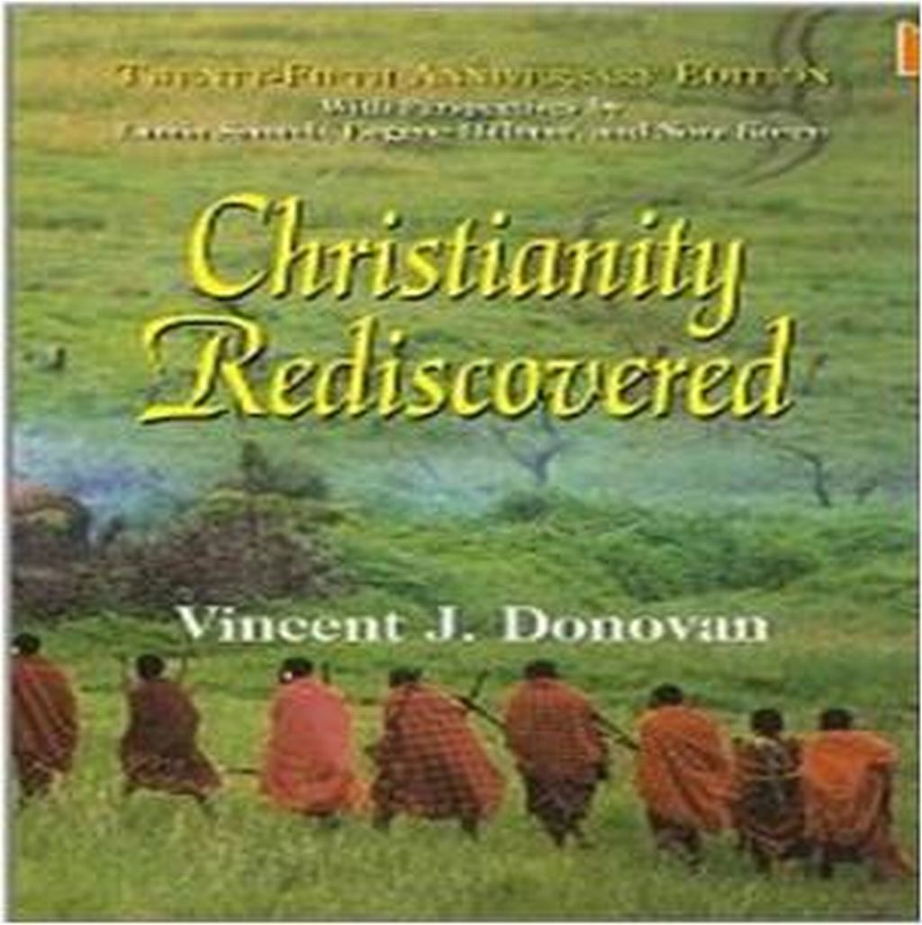
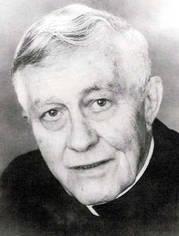
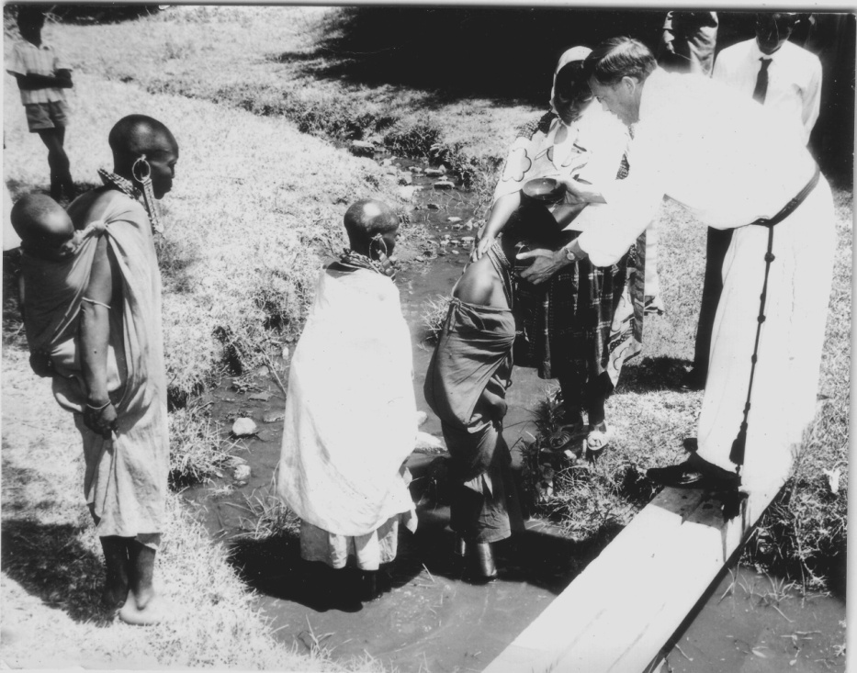
Vincent Donovan
1926 – 2000
Missionary in Tanzania
1957 - 1973
7
Notes:
As the beginning of an answer, we’re going to tell a story.
Vincent Donovan was a Roman Catholic missionary among the Maasai (Meh-sigh) in the 1960s and 1970s. This story is from his book, “The Missionary Letters of Vincent Donovan 1957-1973.” When he arrived in Maasailand, his missionary order had been operating schools and hospitals for some years, but there were no Maasai churches. He got permission from his bishop to go and offer to teach the people in the villages about Christian faith. Many villages were interested. Some said, “Who can refuse to talk about God?” Others asked, “If this is what you are interested in, why did it take you so long?” Donovan’s encounter with the Maasai caused him to rethink his understanding of Christianity and the Gospel and what it means to be church.
At the end of a year of teaching and discussion, he asked the villagers if they wanted to become Christians and be baptised, and many agreed. However, his next problem was what it would mean for the Maasai to form churches. After all, they were a nomadic people, living in wooden huts, and most had no formal education. Where would they meet? How would they worship? And who would be their leaders? Fortunately, by this time Vatican II had happened, so at least they could do the Mass in their own language and not in Latin.
Donovan realised though, that a western-style church was not going to work for the Maasai.

Slide 8
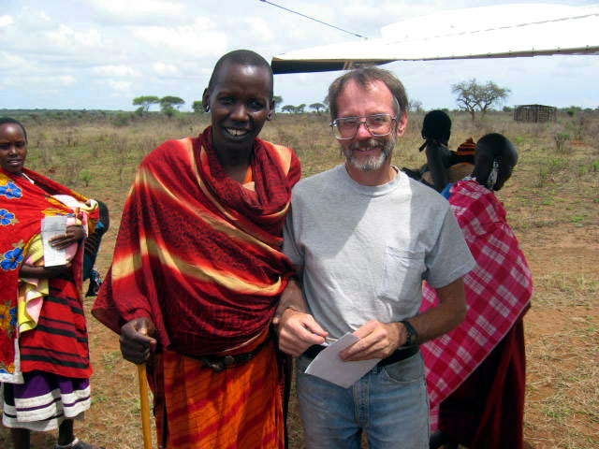
Pat Patten’s story
Notes:
Here is a description of a Maasai Mass from one of his fellow-missionaries, Pat Patten, where he tells of one of the ways that the Maasai began to live and worship as a Christian church.
We would start in the evening when the cows were coming in and the elders would gather up green grass. Green grass is a really powerful symbol of forgiveness, and anyone holding green grass is saying, I’m OK with everybody around here. And if I’m not, I have to go to the person I’m not OK with and get things right.
And so, as the cows were coming in the evening, people would gather the green grass and then, when the cows were milked and everybody was full and at ease, there’s a traditional song the women and men sing. They go in concentric circles, counter rotating, singing two different songs that blend fabulously. And then each woman brings a new piece of firewood. All the fires in the households are extinguished, and the warriors start a brand new fire by rubbing fire sticks together.
And then people would start discussing in the group from the circle what Gospel story most touched them. And there would be some discussion and then kind of a consensus. And then someone would tell the Gospel story and they would tell what happened [in their lives]. And it was not always a success story, it would be sometimes, you know, “We should have been able to do this better,” or “It worked part-way.”
They would finish with a Communion service, which was done on a cow skin, on which all of their special ceremonies are done, with the olorika, a kind of three-legged stool there, and a gourd filled with wine, and a half buffalo horn with bread on it and everyone would be signed with chalk in the form of a cross on their foreheads. For the Maasai, chalk is a sacred symbol of new birth, of initiation, of new beginnings, and in the evening in the firelight, you would see this vivid white on these black faces.

Slide 9
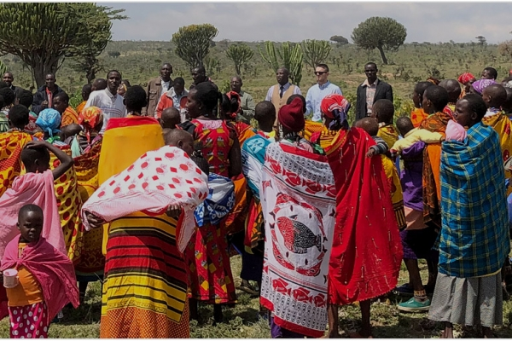
Notes:
People would share the gourd and the buffalo horn and there would be interspersed the Maasai songs. I don’t know if you’ve heard the chant - they always kind of chant - there is always a verse and a refrain. Someone will lead and sing a verse and then everybody sings the response. And it’s a quick back and forth interaction in the singing, not longer, drawn-out verses, the way we often have.
And then in the end, one of the people from the oldest age groups would stand up and take the fresh milk from a cow and gather up all the grass, put it in the gourd, and then sprinkle everybody heavily with milk as a sign of blessing. And then the women would each take a piece of wood from the new fire and take it back to their homes. Then we would stay there the night and leave in the morning.
What strikes you from this story? Take a few minutes and discuss this together in your groups.
<<BREAK OUT ROOMS – 10min>>
The technical term for what Pat Patten describes here is “enculturation” - translating the Gospel into the life of a particular culture. In fact, this is not unique or even new: enculturation has always happened, as the Gospel has attracted people in a new culture, and for centuries churches have met in homes, in the catacombs, under trees, and in pubs, coffee shops and cinemas.

Slide 10

The church must be like water - flexible, fluid, changeable.
- Pete Ward
10
Notes:
We can think of church this way: that the church is like water.
Pete Ward, a priest in the Church of England, has said, “The church must be like water - flexible, fluid, changeable.” Water is always H2O. It can’t be changed to H3O (which is Hydronium) or H2O2 (Hydrogen Peroxide) or H4O (Hydrogen- Bonded Water), or just Ho (Holmium) - those would be something else, and none of them are good for you, in fact they are quite poisonous!
However, just as water can be poured into different kinds of container, so church can be expressed uniquely in different cultural containers.
Look at these examples ….

Slide 11
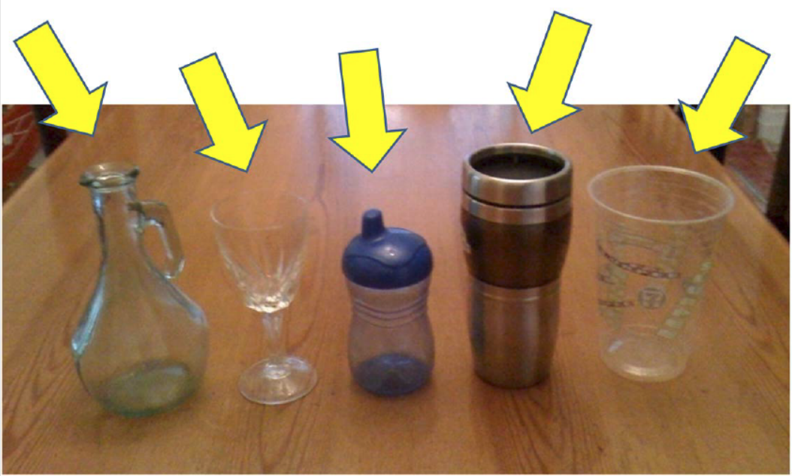
Notes:
Someone might say, Oh, I’ve always drunk water out of crystal wine glasses. They belonged to my grandmother, and I feel they remind me how precious water is.
Someone else may say, But I’m on the road a lot, and I need to take my water with me. Don’t tell me I have to drink it out of a glass: I need a travel cup that won’t spill or break.
A third person may say, Oh water. Sure. I used to drink that out of a sippy cup when I was little. But now I’ve grown up, I don’t really drink water anymore, I prefer tea or fruit juice.
Someone else may not be able to afford a glass or a travel mug, so a cheap plastic cup will have to do.
And as for the flower vase . . . Well, you wouldn’t normally drink water out of it, but if you were stuck in the desert and dying of thirst, you might well drink out of a flower vase or anything else that was handy!

Slide 12
The container may change with the culture
The H₂O must remain the same
But which is which?
Notes:
Of course, the trick is to know what is essential to church (what exactly is the water), and what is changeable according to the culture (what is the container), and different churches have different answers to that question.

Slide 13
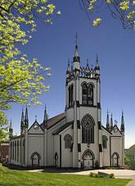
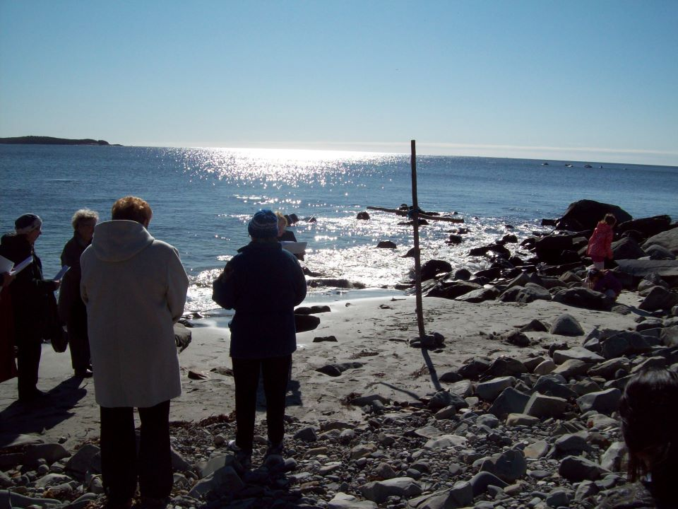
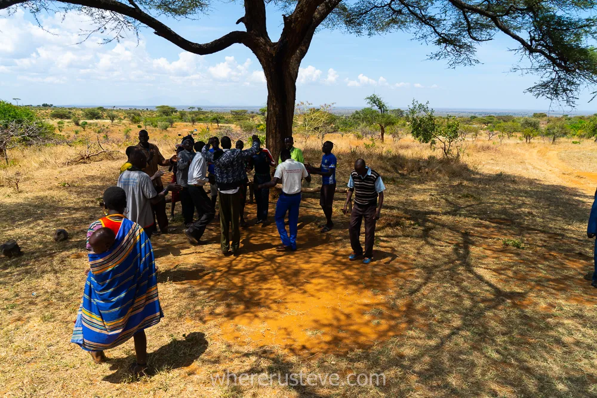
Church
. . . in a building?
…on a beach?
…under a tree?
Notes:
For some, having a building is essential to being a real church: but churches in Africa often can’t afford a building, so they meet under trees. Are they not a real church?
For some, a church building is a place where they experienced deep hurt, but they feel called to worship the divine, so they meet on a beach. Are they a “real” church?

Slide 14
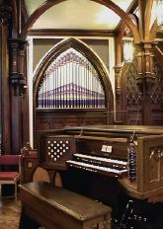
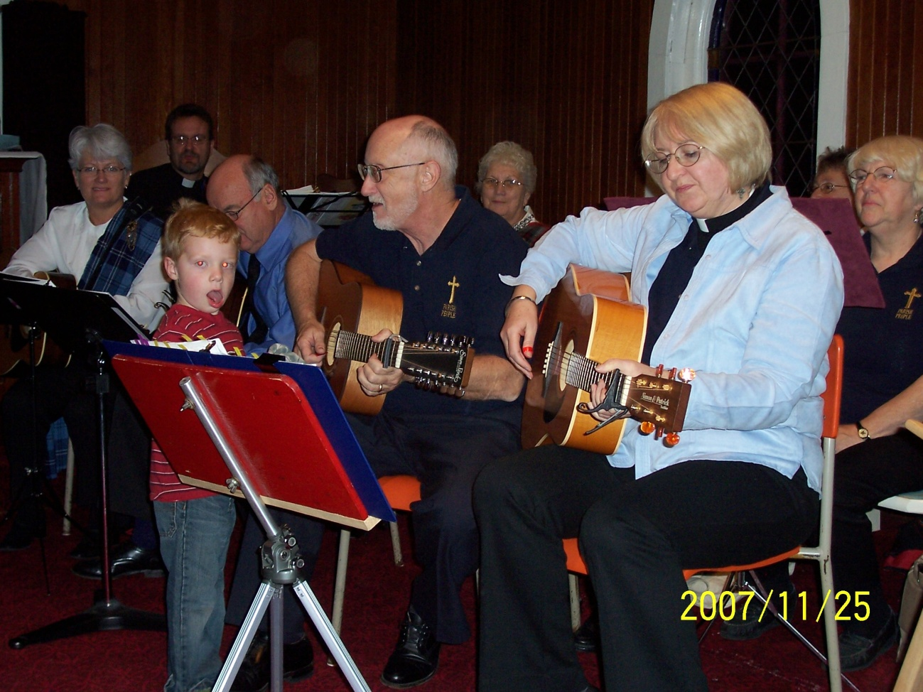
Church . . .
with an organ?
Church . . .
with various
instruments?
Notes:
For others, having a pipe organ is essential: but I am told there was a turning point in the life of the church in the West Indies when the missionaries agreed that churches could use steel drums in worship. So are they not a real church?

Slide 15
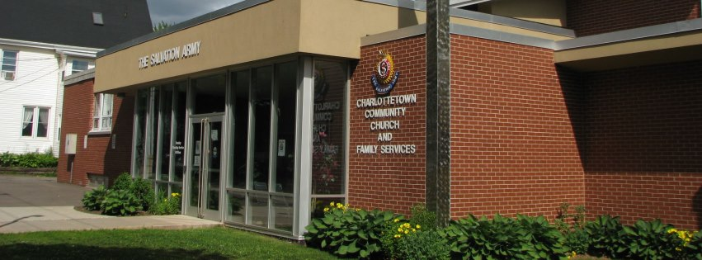

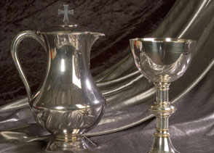
Church . . .
Built on social justice but with no sacraments?
Church . . . with
liturgical worship but
no social justice?
Notes:
The Salvation Army doesn’t have sacraments like baptism and communion, but they would say that practical compassion and social justice are more essential to being a church anyway. So is the Salvation Army a church?
In other churches, the form of worship may be very traditional, and the sacraments may be administered, but there is no interest in social justice, or in the needs of anyone outside the membership. So is that really a church?
Different denominations will draw that line in different places. Wherever we draw that line, however, the crucial questions are:

Slide 16
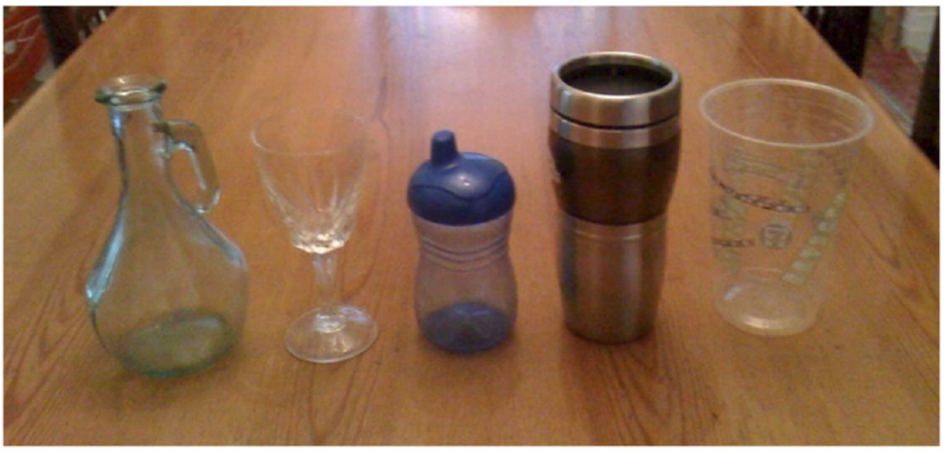
Notes:
Are we willing to put the water of the Gospel in a new kind of container, if it will help some people to drink who can’t presently access any of the containers it’s in?
Might there be times when we confuse the container and the water?
What did we find out about our “containers” during COVID – suddenly the Eucharist wasn’t as important as we thought, was it? Many folks reported that really it was Community that mattered, and we found ways to create it,
even online.
Might we even change our minds about which is the container and which is the water? How much does God care about the container?
What, then, is the water? Perhaps the simplest, most stripped-down answer is the way Mark’s Gospel describes the calling of the apostles.

Slide 17
What is the H₂O of church?
Jesus went up the mountain and called to him those whom he wanted, and they came to him.
And he appointed twelve, whom he also named apostles, to be with him, and to be sent out to proclaim the message, and to have authority to cast out demons.
Mark 3:13-15
Notes:
Will one of you read this for us?
<<reading>>
It’s important to realize here the distinction between disciple and apostle. Disciples are learners who help teach others, but apostles are SENT OUT. Disciples invite others in, and help them become disciples too, in part through recognizing their own gifts and where they can be best used in furthering God mission. Only those who have the gifts to do so become apostles and are sent out to proclaim! Others might be sent out to other kinds of ministries like service or healing or teaching or working for justice.
Mark seems to be giving us a clue as to what is important in Jesus’ disciples, and he names two things: Number one, they were “to be with” Jesus. And number two, they were “to be sent out” in mission to use the gifts God gave them.
So here we have two key parts of the H2O of church: being with Jesus and taking part in his mission.

Slide 18

What is the essence of Church? One answer . . .
H₂O =
Community of followers of Jesus
Gathered for Word and Sacrament
Committed to serving in the world
Linked to the wider church
Notes:
Over the centuries since then, different churches have expanded on those two things: in particular, many have said that the water is being a community of disciples of Jesus and encountering him in the Bible, in prayer, and in sharing
in Eucharist - what we Anglicans call the “ministry of the Word” and “the ministry of the Table.”
It’s also joining Christ in his work for peace and justice in the world.
Others have stressed the importance of being connected to other churches - that if we are all parts of the Body of Christ, it is impossible for churches to be independent of one another. And often bishops or synods, assemblies or conferences, are seen as the connection between different churches. So for many that’s also part of the H2O.

Slide 19
Holy
Worship
Up
Mission
Community
Out
In
Apostolic
One
Of
Connexion
catholic/universal
Notes:
We can put this in the form of a diagram: There is an “Up” dimension – worship: including scripture, prayer, and communion. There is an “In” dimension, where we are a community of disciples of Jesus. There is an “Out” dimension, where we engage in Jesus’ mission together. And there is an “Of” dimension, where we relate to other Christian churches. Or, as that line in the creed puts it, we are “One, Holy, catholic, and Apostolic church.”
And in this case, remember that “catholic” with a small “c” means universal!
Of course, if that is the essence of church, that doesn’t say anything about what kind of building we should meet in, whether we should use a prayer book or not, or what kind of music is appropriate - and a thousand other things we take for granted about church, and worship.

Slide 20
The container may change with the culture
The H₂O must remain the same
What is essential? What can change?
How can people in our culture get to drink the living water?
Notes:
The crucial question then is really: how can people be enabled to access the living water? Or as Tanya sometimes says “drink the kool-aid!” As long as the water is really H2O (not H3O or H2O2), the question becomes whether they can access it best in a wine glass, a travel mug, a sippy cup, a plastic cup, or even a flower vase?
The form church takes should make it easier for people to access the living water of the Gospel: it shouldn’t be a barrier that keeps them away!
So how can people in our rapidly changing culture be invited and encouraged to drink the living water?

Slide 21
Isaiah 43: 14 - 21
The Lord Who bought you and sets you free, the Holy One of Israel, says, “Because of you I have sent to Babylon, and will bring down all their leaders, even the Babylonians, into the ships in which they find joy. I am the Lord, your Holy One, the Maker of Israel, your King.” This is what the Lord says, Who makes a way through the sea and a path through the powerful waters, Who brings out the war-wagon and the horse, the army and the strong man, (They will lie down together and will not rise again. They are destroyed, put out like the fire of a little light): “Do not remember the things that have happened before. Do not think about the things of the past. See, I will do a new thing. It will begin happening now. Will you not know about it? I will even make a road in the wilderness, and rivers in the desert. The wild animals will honor Me, the wild dogs and the ostriches. For I give waters in the wilderness, and rivers in the desert, to give drink to My chosen people. The people whom I made for Myself will make known My praise.
Notes:
As we think about different ways of doing church, let’s look at a passage of scripture that bears directly on this topic of change.
The background is this: The year is around 538 BCE. The people of Judah have been in exile in Babylon for almost seventy years. They have done what Jeremiah told them, and settled down to life in Babylon. Their children had grown up there,
and many of them had done well (like Daniel, who rose to become head of the civil service). Now out of the blue comes this message in the name of the prophet Isaiah.
Will one of you read this for us? <<READING>>

Slide 22
Isaiah 43 Questions
What do we learn about God and God’s ways in the world?
Why do the people need to “forget the past”?
What other times in the Bible can you think of when God does something new?
What response does God hope for from these people?
What promises does God make to them to make it possible for them to respond?
Notes:
Let’s take 10 minutes in your groups and consider these questions related to the Bible passage. They are included in your hand-out on the slide labelled Isaiah 43 Questions. Write down some brief answers.
<<BREAK OUT ROOMS>> 20min

Slide 23

fresh expressions of church
Cameron House
Night Shift
Somewhere Else
What do these stories have in common
How are they different?
What do you learn from them?
Notes:
God is calling us to the future, and the future will be different. But God is the same, and what God does in the future, though it won’t be identical, will have a family resemblance to what has gone before. And God promises to provide theresources we need.
This should encourage us as we think about the future of the church.
So . . . what might a fresh expression of church look like?
Let’s look at models of how Christians and churches have responded to changes in culture. We’ve looked already at the Skater Church in Perth, which happens within the walls of the existing church. We also looked at the story of Destination Church in St. Thomas, which was a totally new Christian community. Now take some time to consider the videos you watched in advance: Night Shift, Cameron House, and Somewhere Else.
They are very different concepts, and yet the same in some important ways.
<<BEAK OUT ROOMS – 10 min>>
What do these stories have in common?
How are they different?
What might we learn from them?

Slide 24
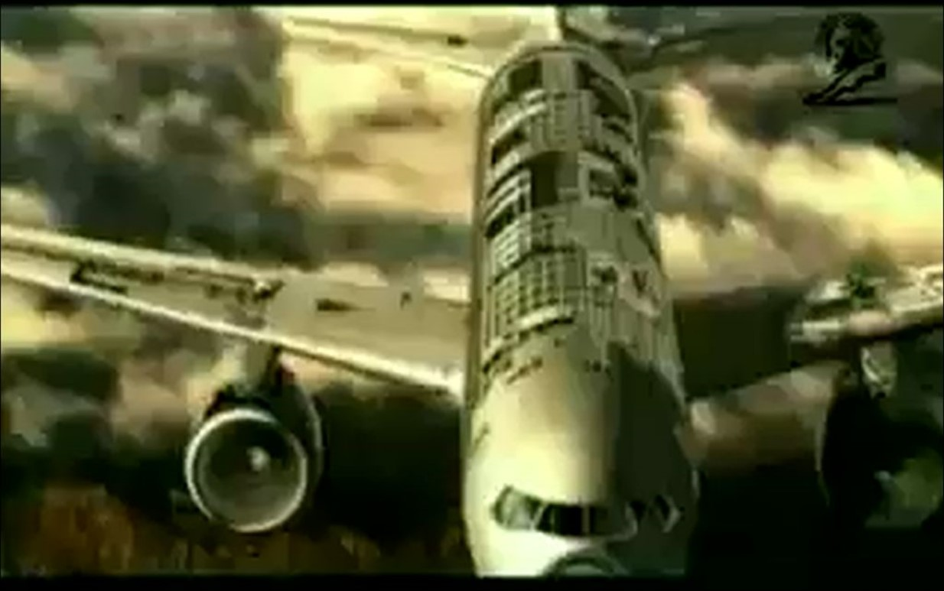
building planes
. . . in the air
Notes:
One thing we note is the relationship between these three fresh expressions and inherited church. Night Shift makes use of the existing church building, but then starts a new worshipping community at a different time of the week;
Cameron House helps people go back to the existing church - but if Deacon Cathy were to be a priest, they could do their own communion services, and (for some at least) they would be a new church; Somewhere Else completely ignored the existing church building and started from scratch.
One commonly-heard slogan in Fresh Expressions is “We’re making this up as we go along!”
Indeed, Bishop Steve Croft, the first Team Leader of Fresh Expressions, told Canadians in 2011 that it is when we stop saying this, and think we know exactly what we are doing, that we will really be in trouble!
The Building Planes in the Air video describes how this process often feels.
Take a few minutes and discuss your thoughts of this video, and whether you or your parish has undertaken a project that left you feeling like this. Or maybe, share an idea you’ve had that you have not yet started, maybe because you aren’t quite ready for that feeling of “building plans in the air”…
<<BREAK OUT ROOMS – 30 min>>

Slide 25



Time for Reflection – The Examen
When was I encouraged, or touched, or joyful?
What might God be saying?
How might I respond?
When was I troubled, or sad, or angry?
What might God be saying?
How might I respond?
Notes:
Before we wrap-up, let’s take this opportunity in quiet reflection to mull over what we’ve heard and discussed this session. Prayerfully we say in the quiet of our hearts, “Speak, Lord, for your servant is listening.” (PAUSE)
You may wish to have a pen and paper handy to make some notes in response to the Examen questions. [Mute everyone]
As we have talked tonight, what have been the moments when you felt positive - encouraged, touched, even joyful?
Were there some things that your spirit said YES to? It may have been something that was said by someone today, an image on the screen, a story, a video, or even a memory.
What made it special?
What might God be saying to you?
Were there moments that caused your heart to sink?
Times when you felt troubled, sad or angry?
It may be something that was said, or something you saw on the screen.
Can you identify what made it difficult?
What might God be saying to you about that?
How might you need to respond?
Remember: God is present in both the joyful and uncomfortable feelings!

Slide 26

Merciful God, creator of the peoples on earth and lover of souls, have compassion on all who do not know you as you are revealed in your son Jesus Christ.
Let your Gospel be preached with grace and power to those who have not heard it, turn the hearts of those who resist it, and bring home to your flock those who have gone astray; that there may be one flock under one shepherd, Jesus Christ our Lord. Amen
Solemn Collect for Good Friday
Notes:
As we close our time together, let’s say this prayer together. It was written originally for Good Friday, but is suitable for other occasions too . . .
<< Read from the screen>>

Slide 27
Next Week….
Where do we go from here?
See you then!
Notes:
Next week we will talk about “Where do we go from here?”
We hope we’ve planted some seeds in these past few weeks. This next week is your chance to consider what you might like to bring to life, or maybe even throw a few more ideas on your list. Next week we will talk about ways to make that happen.
Thank you for your participation and we’ll see you next time!

