Slide 1




The Diocese of Nova Scotia and Prince Edward Island
Notes:
Hi, and welcome back to Re-imagining Church for week 5.
Let’s begin with a moment of silence and then we’ll pray the prayer on the next slide together:

Slide 2
Prayer
Jesus, you invite us to follow you.
Help us, Lord, to follow where you lead us, to join in with what you are already doing in our world, and to become more like you.
We pray in your name, Amen.
2

Slide 3
The Sessions
Session 1: Brave New World?
Session 2: What is God up to?
Session 3: The School of Jesus
Session 4: Changing world, changing church
Session 5: Where do we go from here?
Session 6: Next Steps
Notes:
Well, here we are in our last content‐based session for Reimagining Church 2022.
So . . . Let’s review where we have been in the previous sessions. In session one, we thought about our “Brave New World,” and looked at some of the changes in our culture that have been happening both slowly over the past fifty years, and then very quickly in the past 3 years, and how those changes have impacted the church.
Session Two was “What in the World is God up to?”. We reviewed what spiritual resources we have to draw on, as a kind of compass to find our way forward. In particular, we thought of the Gospel as Good News of God’s love for the world, and God’s desire to put everything to right, focused in Jesus Christ. And we discussed the church as a place where people learn to follow Jesus and work with God in God’s work.
In The School of Jesus, we considered what it means to be a disciple (or apprentice) of Jesus, and how we can grow as disciples. The five ingredients of spiritual growth we highlighted were: community, prayer and worship, the Bible, our faithfulness, and the Holy Spirit. We also thought about helping others become disciples ‐ the aspect of mission we generally call evangelism.
In session 4, we thought about how different churches have adapted themselves and their ministry to the new cultures where we find ourselves, and looked at some different kinds of “fresh expressions.” The goal was to consider how we can change the ‘church’ container to make it accessible for people with whom we want to share the living water Jesus offers, but who would probably find typical Sunday morning worship too weird.
This week we are going to start talking about “Where do we go from here?”
Next week will be very much a working session, so you will have time to put some ideas on paper and start getting a plan in place.

Slide 4
Matthew 7: 24 - 29
“Therefore everyone who hears these words of mine and puts them into practice is like a wise man who built his house on the rock. The rain came down, the streams rose, and the winds blew and beat against that house; yet it did not fall, because it had its foundation on the rock. But everyone who hears these words of mine and does not put them into practice is like a foolish man who built his house on sand. The rain came down, the streams rose, and the winds blew and beat against that house, and it fell with a great crash.”
When Jesus had finished saying these things, the crowds were amazed at his teaching, because he taught as one who had authority, and not as their teachers of the law.
Notes:
Now let’s dig in to a short Bible study.
For many church members of long standing, this is a familiar story. But sometimes familiarity means we don’t see what’s really there. So let’s read it again, and then we have a question for you.
Will someone volunteer to read it for us? <<reading>>

Slide 5

For Discussion:
In the parable Jesus tells, what is the rock?
What does the first builder do that the second does not?
  After all, both of them hear the words of Jesus!
Notes:
Take 10 minutes to discuss this passage and these questions
<<BREAK OUT ROOMS>>

Slide 6

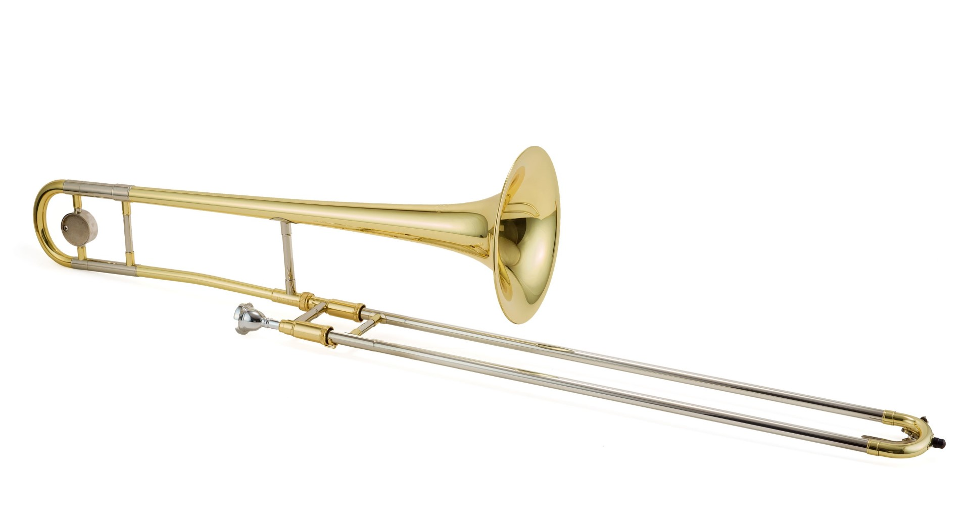


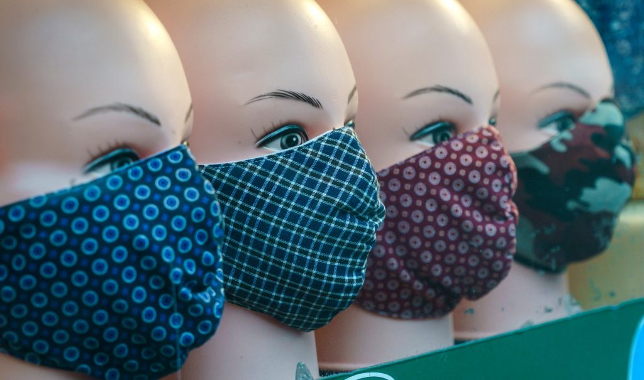
Notes:
Isn’t it curious that we find it so difficult to see that Jesus is asking for obedience? Maybe it’s because obedience is not a particularly appreciated quality in our world! But there are lots of times in our everyday lives where we obey someone. For example, if a policeman tells you to stop, you (hopefully) obey.
Here are some other examples:
• We generally follow most traffic rules.
• We usually take our doctor’s advice, and follow the dosage instructions for medicines.
• If we play a musical instrument, we follow the rules for getting it to make music.
• Every time we speak and are understood, we are obeying the rules of language.
• And of course, during the recent pandemic, many Nova Scotians did a great job following Public Health regulations that kept us safe from COVID‐19.
In many instances, we don’t even think about the fact that we are obeying. It has just become a painless habit. We could even say obedience has become second nature to us. Why do we obey in these situations? Well, it’s usually in our best interest, and in many instances, another person actually cares for us and our well‐being. Sometimes it’s because we care about the well‐being of others!
So obeying Jesus is like that: he knows what will help us become the people we are capable of becoming, and that’s why he asks for our obedience. This is a central part of our discipleship.
As we think about “Where do we go from here?” let’s bear in mind that Jesus may be asking us to obey him in some new ways.

Slide 7
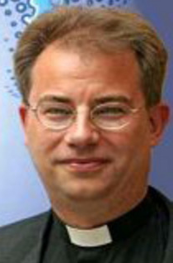
what is a fresh expression of church?
“The attempt to go to where people are, listen carefully to the context and through service form new communities of faith which have the potential to grow into church in their own right.”
- Bishop Steve Croft
Notes:
As we get deeper into this topic, let’s start with a definition of a fresh expression of church.
This one comes from Bishop Steve Croft, who was the first Team Leader of the Fresh Expressions initiative in the UK. It’s a bit different from the one we’ve used before:
A fresh expression of church is “the attempt to go to where people are, listen carefully to the context, and through service form new communities of faith that have the potential to grow into church in their own right.”
Before we ask you for feedback on the definition, here’s a fun little video about what fresh expressions are not. Then we can contrast what they are and what they are not.
Show “fresh expressions of church: a medieval video.” [40sec]
https://www.youtube.com/watch?v=PfF_‐wbMr3M
Do you see the difference? There’s nothing wrong with those things in the video ‐ of course. They are important forms of outreach. But their goal is probably to help people find a place in the existing (inherited) church, not to grow into a new church. That’s the difference.

Slide 8

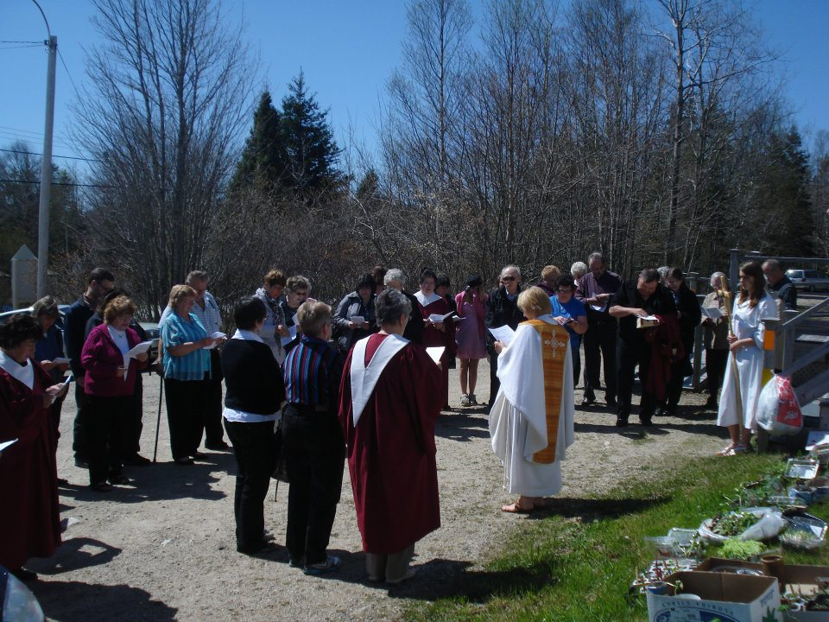
PRAYER
Listening &
following
God’s call
Loving
Service
Forming
Community
Evangelism
& Disciple-
Making
Evolving
Worship
Connection & Support
8
Notes:
A fresh expression of church can begin with going, then listening, then serving, then forming community, and finally (perhaps) growing into a church. This came through most clearly in the Somewhere Else video from last week, about the “bread‐making church”.
The minister, Barbara Glasson, walked the community’s streets for a year before she started anything. Only then did she gather a group to make bread. Out of that came a community where people told their stories and faith was shared. And only after that did a worshipping Christian community begin to emerge.

Slide 9

(Lots of) Other Ways to Create a Fresh Expression
Notes:
If you would like to read lots more examples of freshexpressions, and see some other “pathways” to get there, I recommend the book “Being Church, Doing Life”. We read it as part of Connectors One. It is very British in its examples, so if you are looking for Canadian examples, “Going Missional” is also available on Amazon.ca and it is all Canadian stories.

Slide 10

So…. How do we begin?
Notes:
It’s important that we understand Fresh Expressions of church, as there is a clear distinction between these and inherited forms or traditional church.
You may say, “We’ve never done things this way before.” Some have called those “the seven LAST words of the church.” And certainly it can be scary to do new things in a new way with new people ‐remember our Bible study on Isaiah 43, and “the new thing”!
So where do we begin?
The quick answer is: we begin by listening. The “Listening for Mission” audio file that we asked you to listen to in advance features several practitioners of fresh expressions talking about their own experience of figuring this out.
“Listening for Mission” – audio file.
What stood out for you? Group Conversation

Slide 11
360 listening
Community leaders
Our church & other churches
Scripture & prayer
Community members
Notes:
One thing we think worth underlining is the concept of “360 listening” ‐ where you listen not only:
the people in your church (of course) but also:
... to God in scripture and prayer
... to people in the community who are not involved in church
... to people in other churches
...and to civic leaders such as town councillors, store owners, the police and so on.
This is normally the first step for a church that wants to turn outwards and be more missional. What does that look like in practice? Here are some ideas:

Slide 12
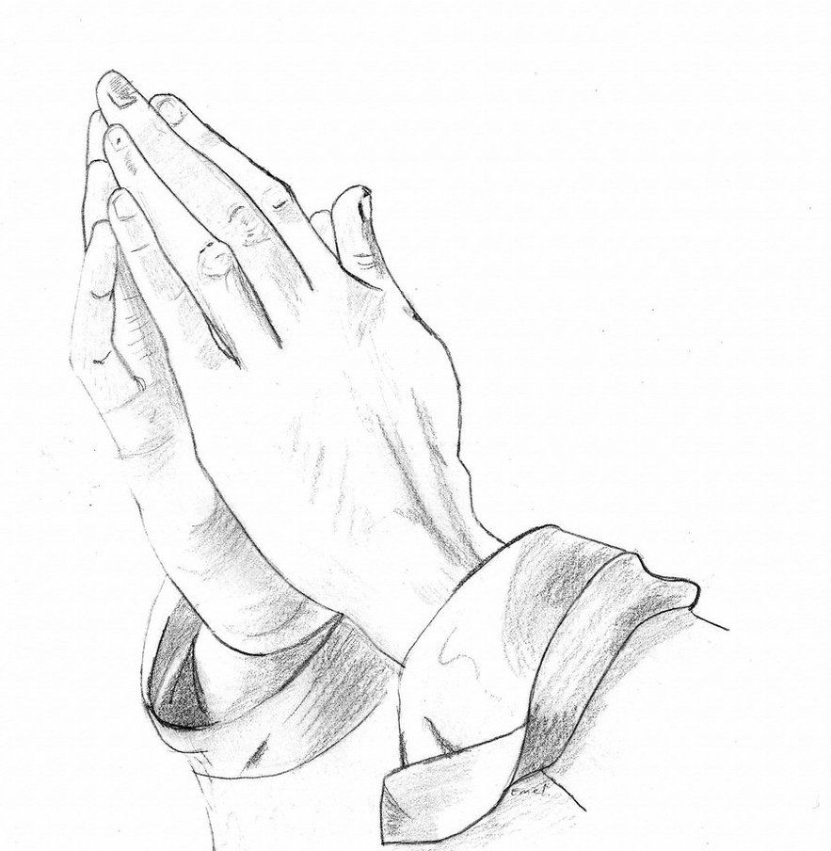

Where do we start?
Include outreach to your neighbourhood in the church’s weekly prayers.
Add a budget line to your church’s budget for local outreach.
Notes:
Include outreach to your neighbourhood in the church’s weekly prayers. Perhaps have a sermon series on mission, and look more deeply into what the Bible says about it.
Add a budget line to your church’s budget for local outreach. Begin with $500. Perhaps you could announce to the congregation that the money is available for outreach projects, and that they should submit ideas.

Slide 13

Do a survey of the congregation and ask: “What gifts do you have that might be used in ministry outside the church?”
  friendship,
  hospitality,
  speaking a second language,
  internet skills,
  financial expertise,
  working with children,
  making connections between people
Notes:
Do a survey of the congregation, asking, “What gifts do you have that might be used in ministry outside the church”
For example: friendship, hospitality, speaking a second language, internet skills, financial expertise, working with children, making connections between people.

Slide 14

Talk to leaders in your community, e.g. the local MP, the police, the mayor, or councillors. Ask such things as:
  “How might a church serve this community?”
  “Are there times in the year when you need volunteers for a service project in the community?”
  “Would you let us know if and when there are issues you would like us to pray about for you?”
Notes:
Talk to leaders in your community, e.g. the local MP, the police, the mayor, or city councillors.
Ask such things as:
• “How might a church serve this community?”
• “Are there times in the year when you need volunteers for a service project in the community?”
• “Would you let us know if and when there are issues you would like us to pray about for you?”

Slide 15




Do a survey of people on the streets and store owners in your community. Ask such things as:
  “What do you see as the needs of this community?”
  “How has this community changed, for better or for worse, in recent years?”
  “What might a church contribute to this community?”
Notes:
Do a survey of people on the streets and store owners in your community.
Ask such things as:
• “What do you see as the needs of this community?”
• “How has this community changed, for better or for worse, in recent years?”
• “What might a church contribute to this community?”

Slide 16




Talk to people in other churches in the neighbourhood:
  How are they involved in the neighbourhood?
  What needs are they aware of?
  Can they see ways in which the different churches’ efforts might be complementary?
Notes:
Talk to people in other churches in the neighbourhood. How are they involved in the neighbourhood? What needs are they aware of? Can they see ways in which the different churches’ efforts might be complementary?

Slide 17

Discuss the findings with your church leaders, and ask God for direction. Don’t be afraid to start, and don’t be afraid to make mistakes. Make haste slowly!
Notes:
Discuss the findings with your church leaders, and ask God for direction. Don’t be afraid to start, and don’t be afraid to make mistakes. Make haste slowly!
This is a process that might take six months or more before you decide what God is calling you to do. But better that than rushing into something just because you want to get on with something, but which doesn’t work out because it wasn’t really the right thing, and leaves people with a bad impression.
Any thoughts jump to mind? Are there other things that you have seen or heard about other churches doing, that we should add to this list?
Take a minute of quiet now, and make a few notes, then we’ll give you time to discuss with your group.
<<BREAK OUT ROOMS – 10 min>> → what’s one or two things you can do THIS WEEK to get started on this process?
Although we won’t go into further detail here, there is a link on the web site for this week’s session to a video by Michael Frost where he covers 5 “Ss” that can help you get to know your community. It’s a different perspective on the same piece of work, which you may find helpful. There’s also a summary handout.

Slide 18
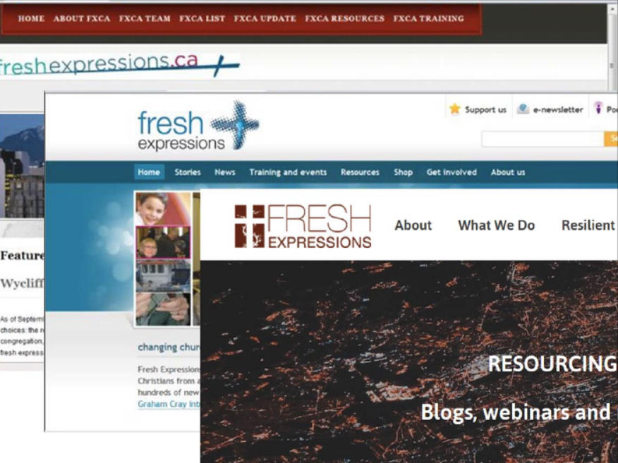
Notes:
As you move ahead, we want to remind you about some other resources, which are all linked on the web site under this Session.
There are websites for Fresh Expressions in Canada, the US, and the UK that are packed with ideas and stories.

Slide 19
Time for Reflection
Notes:
We’re going to take some time now to try and bring all these threads together. Take a moment in silence and write down your responses to what you’ve seen and heard in the past few sessions. Jot down and thoughts about the future, both the hopes and the fears. Just a few words to remind you of key points that have been significant for you.
<<time of silence>> 3 min
Before we move into a more detailed set of questions, I’m going to read a piece of scripture that you may recognize from last week, and a short reflection. Then we’ll read a responsive prayer litany.
-------------------------------------------
Scripture
This is what the Lord says - he who made a way through the sea, a path through the mighty waters, who drew out the chariots and horses, the army and reinforcements together, and they lay there, never to rise again, extinguished, snuffed out like a wick. “Forget the former things; do not dwell on the past. See, I am doing a new thing! Now it springs up; do you not perceive it? I am making a way in the wilderness and streams in the wasteland. Isaiah 43:16-19
Reflecting
To be a Christian is to have received new life, to have become new life. ‘The old has passed away; behold the new has come!' Through baptism, our old selves have been buried in the tomb of Christ and we have risen with him to newness of life. Surely one of the most amazing and provocative thoughts in our faith! Yet how little the impact it makes on us.
Indeed, how often do the lives we live contradict the truth of what we are! We stay stuck in the tomb, we cling to what is dying, we lack faith in what is being born. We fear the light of the dawning sun. Sometimes we do not notice even, so accustomed have we become to what is familiar and comfortable.
To be a Christian is to believe in the new. To be a Christian is to believe in a God of newness, perpetually active among us, forever bringing the new out of the old, transforming the tomb of death into a womb of new life. To be a Christian is to dare to attempt to see as God sees.

Slide 20
We believe in God
The one who reveals new life when all seems dead.
We believe in the New
In the incarnation, which renews the face of the earth.
We believe in Christ
the pledge to us of God’s promise of new life.
We believe in the New
in the possibilities in our midst that challenge us to see with new eyes.
We believe in the Spirit
whose power within enables us to make things new.
We believe in the New
the new heaven and earth coming to birth before our eyes.
Notes:
Annie’s going to read the lighter type, please join in reading the bold text together.

Slide 21
The View From Here
What have you learned?
What might God be calling you to?
What might the next step be?
If you have an idea about that, what’s the first thing you need to do?
What resources do you need?
Notes:
We call this exercise “The View from Here”. This will be another few minutes of personal reflection. The questions are on the screen & in your handout.
What have you learned, about God, about church, about mission – or indeed, about anything else?
Based on what you’ve learned in this course, what might God be calling you to?
You can also reflect on what the next step might be for you and your community.
And, if you have an idea what that might be, what’s the first thing you need to do once this evening is over, in order to set things in motion?
We’re going to give you a few minutes to make some notes.
<< SILENT TIME – 3 min >>

Slide 22
Prayer
Christ now sits at the right hand of the Creator and calls us into God’s future.
God going ahead of us assures us about what is new.
May the Lord who lies ahead of us and beckons us forward, teach us to trust the unknown and to embrace new life, now and every day.
Amen.
Notes:
Please join us in reading this prayer on the screen together

Slide 23
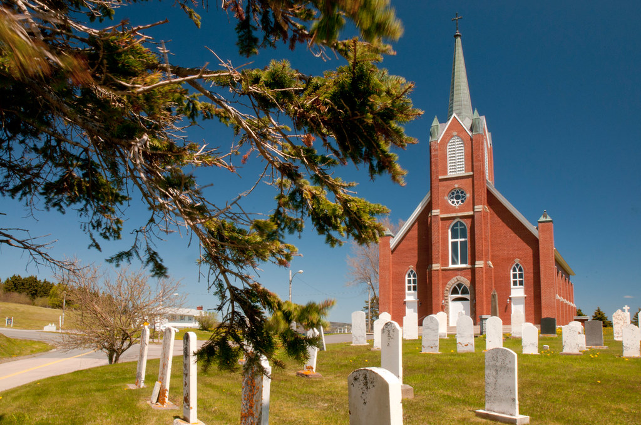

Getting “Out of the Box”
Notes:
The original Re‐Imagining Church series was filmed at Granite Springs Golf Course in Bayside, Nova Scotia. The series was filmed at that location because we wanted to encourage folks to think outside of the “church building” box, so to speak. Some of you may be golfers and spend a great deal of time in a place like that. Or maybe you spend time at a bowling alley, or a Tim Horton’s coffee shop. Maybe you have a Legion or a community hall in your area? Or have access to a common room in a local senior’s complex. Maybe you spend a great deal of time in hockey arenas or on a baseball field or a school playground.
Regardless of where you are located, in cities, towns or villages, in Nova Scotia or Prince Edward Island ‐ wherever you are – there are people who have not heard the Good News of Jesus Christ and have not experienced the blessings of being part of a faithful, lively and caring Christian community. What might God be calling your congregation to become, to meet those folks wherever they may be?

Slide 24
For Discussion
What have you learned?
What might God be calling you to?
What feels exciting about that? Or not?
What might be the next step for your community?
What’s the first thing that needs to happen, to set things in motion?
Notes:
Now, we’re going to invite you to share your thoughts in your group.
The questions are similar, but not quite the same, so we’ve put them on a different slide.
We will take 20 minutes for this. If you are done sooner, just leave your room and re‐join the main room.
<<BREAK OUT ROOMS>>

Slide 25
Evaluation
What are we measuring to define “success”?
Notes:
So how will you know if “it worked”? I think we can all agree that just counting to bums in the seats isn’t always (and maybe never was) a good measure of “success”. But how else can we know?
Rather than viewing evaluation as a judgement, consider it a contribution to the process of Spiritual discernment – not to assess whether an initiative should be supported, but where and how the Spirit has been at work. In this view, evaluation is a means of learning from experience and a process of recognizing fruitfulness.
Fruitfulness is just the results of your decisions and actions. An event could be fruitful even if very few people showed up, if someone happened to make an off‐hand remark that sparked an idea for something else to try instead. It is not just a measure of numbers, but also includes the signs of the Spirit at work on the journey. It is not as easy as just counting who showed up. It takes effort to discern whether outcomes have a flavour of what the Spirit is calling you to next.
In this context, the creation of a Christian community that conforms to existing expressions of Church wouldn’t be considered “success”. Rather it is the development of a new expression that has the capacity, through the Spirit, to challenge and enter into dialogue with existing Church so they can move forward together, growing into a fuller understanding of Christ.
Evaluation is, therefore, a shared journey of the inherited church and its fresh expressions. It will probably be messy and there is no one‐size‐fits‐all process. The stakeholders can learn from Acts 15 where there was conflict between Gentiles wanting to join the new Christians, but they didn’t like all the rules that came with the rules of the Jewish church. In order to continue walking together, there must be honest conversation, careful listening, story‐telling, interpretation using Scripture, a commitment to remaining together, and willingness to give and take.
There is much more that could be said, but not a lot of time to go there, so I commend to you Appendix One in the Michael Moynagh book we referred to earlier – Being Church, Doing Life. The basic idea is that in order to evaluate well, you need to know what data to collect before you start (and it might even change as you go along)
We are going to give you some time to discuss this in your groups, particularly focusing on how you currently measure “success”, compared to how it might look with new missional initiatives or fresh expressions.
<<BREAK OUT ROOM – 10 min>>

Slide 26



Time for Reflection – The Examen
When was I encouraged, or touched, or joyful?
What might God be saying?
How might I respond?
When was I troubled, or sad, or angry?
What might God be saying?
How might I respond?
Notes:
We are going to wrap up with some time for personal reflection. You may wish to have a pen and paper handy to make some notes in response to the question we are going to ask. [Mute everyone]
As we have talked tonight, what have been the moments when you felt positive - encouraged, touched, even joyful?
Were there some things that your spirit said YES to? It may have been something that was said by someone today, an image on the screen, a story, a video, or even a memory.
What made it special?
What might God be saying to you?
Were there moments that caused your heart to sink?
Times when you felt troubled, sad or angry?
It may be something that was said, or something you saw on the screen.
Can you identify what made it difficult?
What might God be saying to you about that?
How might you need to respond?
Remember: God is present in both the joyful and uncomfortable feelings!

Slide 27
Prayer
O God who created us, fill our minds with knowledge and appreciation of the dream with which, and for which, you created us.
O God who created us, fill our hearts with courage to take the risks and pay the price that will make this dream come true.
O God who created us, breathe life and energy into our hands, that we may always find joy in dreaming your dream into reality.
Through Christ our Lord, Amen.
Notes:
Please join us in reading the prayer on the screen together.

Slide 28
Next Week
No lecture stuff
Time to “work”
Time for discussion
Brainstorming, planning, ideas for financing and finding other resources
Notes:
Next week we encourage you to come back with your thoughts, ideas, questions, ready to start putting a plan together for “what’s next”.
It will not be a “talking head” session, but rather a working session to help get you moving.
We are hopeful that Rev. Lisa will join us to help with brainstorming, planning, and even ideas for financing!
And just for fun, we will try some “scario scenarios” from MORE Mission School session 4, to get us thinking about those every day conversations that we have, where we have a chance to plant a seed or build a relationship but we aren’t always sure what to say.

