Slide 1


BUILDING BLOCKS
HEALTHY PARISHES
Presentation for Parishes and Regions
Diocese of Nova Scotia & Prince Edward Island

Slide 2

Church and Culture
Notes:
We have all probably noticed the great changes in our society and culture over the years.
Families and individuals are not as connected to the church as in generations past. In fact, it is accurate to say that for the most part we are missing the Baby Boomer generation (Born 1946 to 1964), Generation-X (Born 1965 to 1976) and now the Millenials (Born 1977 to 1995).
Think about it. How many of your children, grandchildren, nieces and nephews, are active in their faith and church community?
Other changes in our culture include a vast increase in options for Sunday morning activities, whether it be sports, shopping, more people employed in shift-work, and other recreational activities. Massive developments have come about in our society with things like Smart phones, the Internet, the way we use money, and preferences about how we use our leisure time. Then there is a declining trust in authority and of institutions, as well as broader view of pluralism.
Things have changed a great deal and our parishioners now find themselves quite disconnected from the communities in which we live and serve.

Slide 3
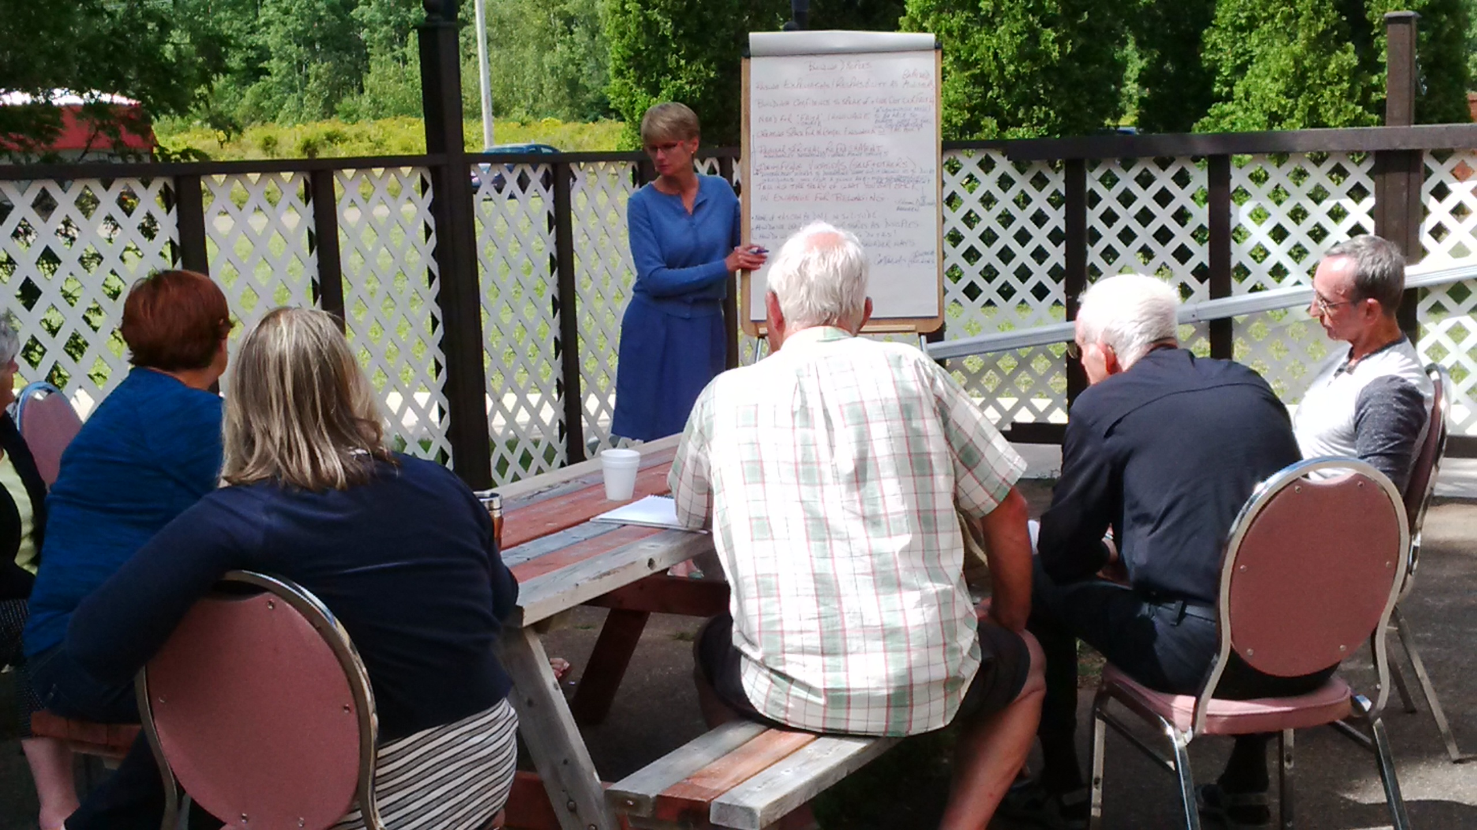
PLANNING RETREAT – August 2016
Hosted by Building Healthy Parishes Team (VSST)
32 lay and clergy invited
Various parish contexts, roles
19 people participated
All regions represented (except PEI)
Preparation reading
Notes:
In the spring of 2016 the Building Healthy Parishes Team, with the support of Diocesan Council, organized a planning retreat to carefully and prayerfully consider addressing the disconnect between parish life and the society in which we minister.
A variety of lay and clergy leaders were invited from all types of parish settings, rural, town, suburban, and urban. Represented were Lay Readers, Council members, Christian education facilitators, rectors, associate priests, vocational deacons, archdeacons, regional deans and even one bishop!
Several articles for preparation reading were assigned to invitees, as well as a glossary of terms.

Slide 4

THREE FOUNDATIONAL BUILDING BLOCKS
Christian Formation
Building Disciples
Leadership
Notes:
The planning event, held in Debert, focused on three main areas of interest. These pillars or building blocks are: Christian Formation, Building Disciples, and Leadership Models.
The core themes chosen were based on many conversations and questions raised among the Building Healthy Parishes Team, from several congregations, and even as a result of parish crises that had emerged over the previous year or more.
Each of the three topics is related to other, with Christian Formation representing the beginning stages of faith, moving to Building Disciples, with more maturity in Christian identity, and finally Leadership, the embracing and ‘releasing’ of disciples in their respective roles to take on ministry, whether lay or ordained.
The process used to discuss and deliberate was the same as the one we used at Diocesan Synod in 2015: What is? What could be? What will be?

Slide 5

CHRISTIAN FORMATION
    Introducing Christianity
    Fostering spiritual (re-)awakening
    A life-long process of ‘growing’
    Leads to spiritual fulfillment
    Is more than education
Notes:
This presentation emphasizes and explores issues involving Christian Formation. (The other two themes will be examined another time.) So, what do we mean by Christian Formation?
This refers to the very beginning stages of helping people explore Christianity, and also how we can foster an awakening (or a re-awakening) in belief and devotional behaviours. It involves ways to introduce people to Christ and inviting them to discover the riches of his glory for themselves. (By the way, this priority was named in table discussions during our Diocesan Synod in 2015.)
One definition of Christian Formation is that it is the lifelong process of growing in our relationship with God, self, others, and all creation. It is a continuous journey – always questioning, wondering and learning. We are constantly being formed as Christians and throughout our lives we seek opportunities to find spiritual fulfillment.
To be clear, Christian Formation is more than Christian Education because education implies a finish – a person graduates and receives a diploma or certificate and moves on to the next stage of life.
Pew Research Centre released a study a few years ago that showed that “the number of Canadians who do not identify with any religion has been rapidly rising in recent decades, going from just 4% in 1971 to 24% in 2011.” More and more people in our neighbourhoods have little or no understanding of what authentic Christian faith is about and how it might be actively lived out in a church community.
This Christian Formation building block is central to congregational vitality and ministry, now and for the future.

Slide 6

QUESTIONS FOR DISCUSSION:
What are you doing in your parish relating to Christian Formation?
How are you addressing the beginning and basic spiritual needs for…
    Children?
    Youth?
    Adult ‘Seekers’?
    Long-time parishioners?
Notes:
Let’s take a few minutes (announce how many – 10 minutes, etc.) and discuss these questions.
(You may wish to record responses on Flipchart paper or have someone take notes for future consideration.)

Slide 7

QUESTIONS FOR DISCUSSION:
How well do you know your neighbours?
What groups of people (demographics) from your neighbourhood are NOT reflected in your congregation?
Notes:
We will take (10, etc.,?) minutes to explore these questions related to the population around us, the one we are called to serve in our church(es).
Often our congregations do not reflect the people in the neighbourhood around us.
Who is missing?
What ages and backgrounds are not reflected in our parish make-up?
(Again, you may wish to record responses on Flipchart paper or in notes.)

Slide 8

THE GREAT COMMISSION:
Jesus said, “Go therefore and
make disciples of all nations,
baptizing them in the name of the Father
and of the Son and of the Holy Spirit,
and teaching them to obey everything
that I have commanded you.” – Matthew 28:19,20a
Notes:
The imperative is clear for the Christian church in Jesus’ command, that which we call “the Great Commission.”
Christian Formation is not an option, but the foundation for all our life and ministry together as Church.
The approach to this, the strategy so-to-speak, may change according to the culture, but the mission call is sacred.
One university professor, Andy Molinski, calls this “global dexterity: The ability to adapt behaviours across cultures without losing who you are in the process.”

Slide 9

HOW DID JESUS & THE EARLY CHURCH DO IT?
New Testament examples of how people were helped to explore faith and become disciples:
Invited ‘seekers’ to investigate Jesus, “Come and see!” (John 1:35-42)
Jesus invested time with those who were interested (John 3:22)
His disciples engaged the community, served and shared the Gospel (Luke 10:1-11)
The first Christians went where people gathered and entered into conversations about Christ (Acts 16:13-15)
Notes:
It is always a good idea to remind ourselves of how our Lord and disciples in the early church crossed the gap between the culture of the day to connect with people about faith.
(OPTION: Let’s listen as these Bible passages are briefly read aloud. (See scripture hand-out documents. Ask different people to read the passages.))

Slide 10

CHRISTIAN FORMATION MEANS CONNECTING
Jesus used every opportunity to work with his disciples to teach, to form, to help them grow as his followers.
His approach was simple, non-pressured and
connected with people where they were.
He did not have a big budget,
a large staff or fancy equipment.
Notes:
Ultimately Christian Formation means connecting with people and helping them connect deeply with Christ.
Sometimes in the church we imagine that this kind of ministry is complicated or involves a large program.
If we follow Jesus’ example, we see that effective ways to do Christian Formation can be simple and approached in a relaxed, non-pressured manner. It is just connecting with people where they are and how they are.
We also note that the vast majority of Jesus’ disciple-making did not take place in the temple or synagogue (church setting).
Jesus connected with people in an authentic, relational way wherever he went – on the road, at central gathering places (Samaritan woman at the well), in the marketplace and in homes, often over a meal.

Slide 11

CHRISTIAN FORMATION: ASSEMBLY REQUIRED
WHERE CAN YOUR CHURCH BUILD IN CHRISTIAN FORMATION?
  Existing gatherings of people (meetings, groups, clubs, etc.)
  On-going activities, events
  Current programs, studies
WHAT STRENGTHS CAN YOU BUILD UPON?
  Hospitality
  Facilitation of discussions
  Teaching, etc., etc.
Notes:
All churches have existing strengths and assets for Christian Formation.
Our generous God gives us more than we need to carry out the mission work to which we are called.
What are the people-gatherings you already have in your parish?
What are the events, activities, programs and studies that you have in place or have hosted before?
What about the gifted people you have in your congregations? The parishioners who have time and talents to share?
What things do you currently do well that you can leverage to help with initiatives for Christian Formation?

Slide 12

IDEAS & RESOURCES:
Faith Sharing Cards
Christian Formation studies
Education for Ministry (EFM)
Teens Encounter Christ (TEC)
Cursillo retreats
Diocesan Youth Conference
Bulletin and Newsletter inserts
Movie Nights & Book Clubs
You Tube videos/channels
Faith Explorers group
Notes:
There are numerous ways to foster and encourage Christian Formation. The most effective approach is through small group gatherings, whether that be through short ‘faith sharing’ exercises at church meetings, hosting The Alpha Course, or attending more intensive programs like EFM or Cursillo.
The Building Healthy Parishes Team is planning to get “Faith Sharing Cards” specially printed and distributed to every parish this spring. To access these question-cards immediately, you may print a set on card-stock weight paper. See the details on your hand-out.
In order to experience lasting transformation within the church community both lay and clergy leaders need to be intentional and focused in their Christian Formation efforts. Regular and consistent emphasis is required if we are to maintain this foundation of our faith in our parishes.
You will see on the hand-out provided all kinds of ideas and resources. Most of these can be accessed through our Diocesan website. Some of them are free to obtain.
For inquiries, contact the Building Healthy Parishes Team Leader, Tanya Moxley, or the Diocesan Parish Vitality Coordinator, Lisa Vaughn.

